Slide 1
New Jersey’s Preliminary Analysis of EPA’s 2017 AirToxScreen
April 7, 2022
NJDEP - Division of Air Quality

Slide 2
AirToxScreen Background
AirToxScreen is a screening-level characterization of air toxics across the nation
Nationwide assessment with census tract resolution
Cancer and noncancer risk estimates for about 140 HAPs with health data based on chronic exposures
Ambient concentration estimates for 180 Clean Air Act HAPs plus DPM
AirToxScreen Uses
To identify locations of interest for further study
To prioritize pollutants and emission sources
To inform monitoring programs

Slide 3
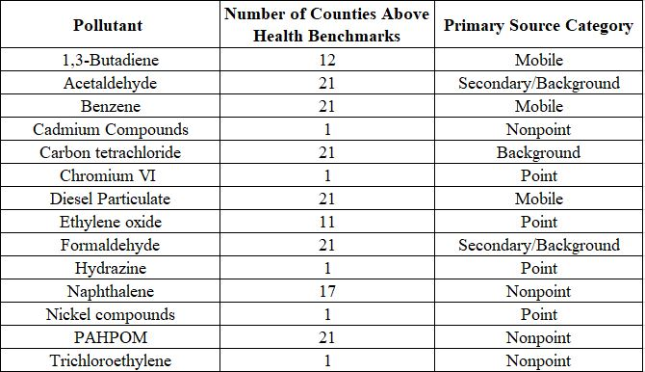
New Jersey’s Air Toxics of Concern

Slide 4
New Jersey Statewide Average 2017 AirToxScreen Modeled Air Concentrations Compared to Health Benchmarks
Pollutant | Modeled Air Concentration (µg/m³) | Health Benchmark (µg/m³) | Risk Ratio | % Contribution by Source Category
 |  |  |  | Point Sources | Nonpoint Sources | Onroad Mobile | Nonroad Mobile | Background & Secondary
1,3-Butadiene | 0.038 | 0.033 | 1.2 | 5% | 13% | 50% | 30% | 2%
Acetaldehyde | 0.92 | 0.45 | 2.0 | 0% | 5% | 7% | 3% | 85%
Benzene | 0.45 | 0.13 | 3.5 | 2% | 25% | 43% | 29% | 1%
Cadmium Compounds | 0.000060 | 0.00024 | 0.25 | 31% | 36% | 0% | 33% | 0%
Carbon tetrachloride | 0.52 | 0.17 | 3.1 | 0% | 0% | 0% | 0% | 100%
Chromium VI | 0.000031 | 0.000083 | 0.37 | 58% | 35% | 4% | 3% | 0%
Diesel Particulate | 0.52 | 0.0033 | 158 | 0% | 0% | 44% | 56% | 0%
Ethylene oxide | 0.00025 | 0.00020 | 1.3 | 72% | 28% | 0% | 0% | 0%
Formaldehyde | 1.2 | 0.077 | 16 | 2% | 5% | 5% | 6% | 82%
Hydrazine | 0.0000038 | 0.00020 | 0.019 | 100% | 0% | 0% | 0% | 0%
Naphthalene | 0.040 | 0.029 | 1.4 | 5% | 48% | 32% | 15% | 0%
Nickel compounds | 0.00062 | 0.0021 | 0.30 | 38% | 19% | 7% | 36% | 0%
PAHPOM | 0.021 | 0.0010 | 20 | 3% | 61% | 21% | 15% | 0%
Trichloroethylene | 0.028 | 0.20 | 0.14 | 2% | 98% | 0% | 0% | 0%

Slide 5
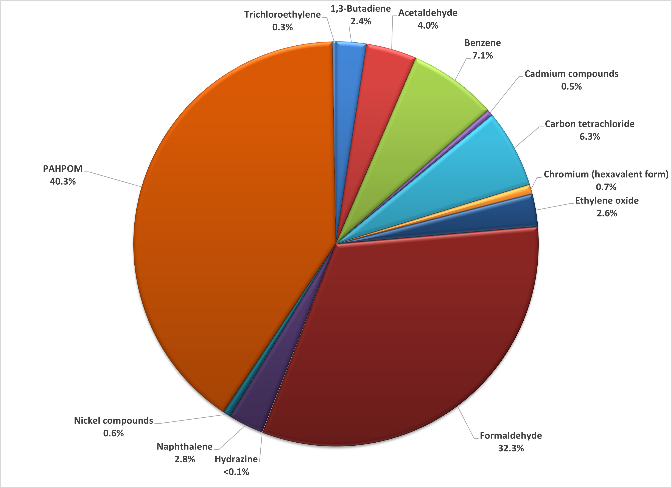
2017 AIRTOXSCREEN Pollutant Contribution to Cancer Risk without Diesel

Slide 6
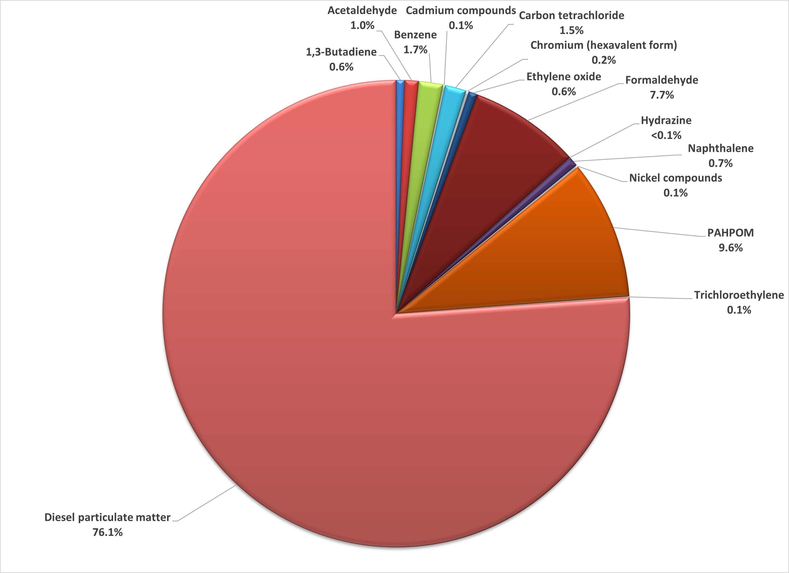
2017 AIRTOXSCREEN Pollutant Contribution to Cancer Risk for New Jersey

Slide 7
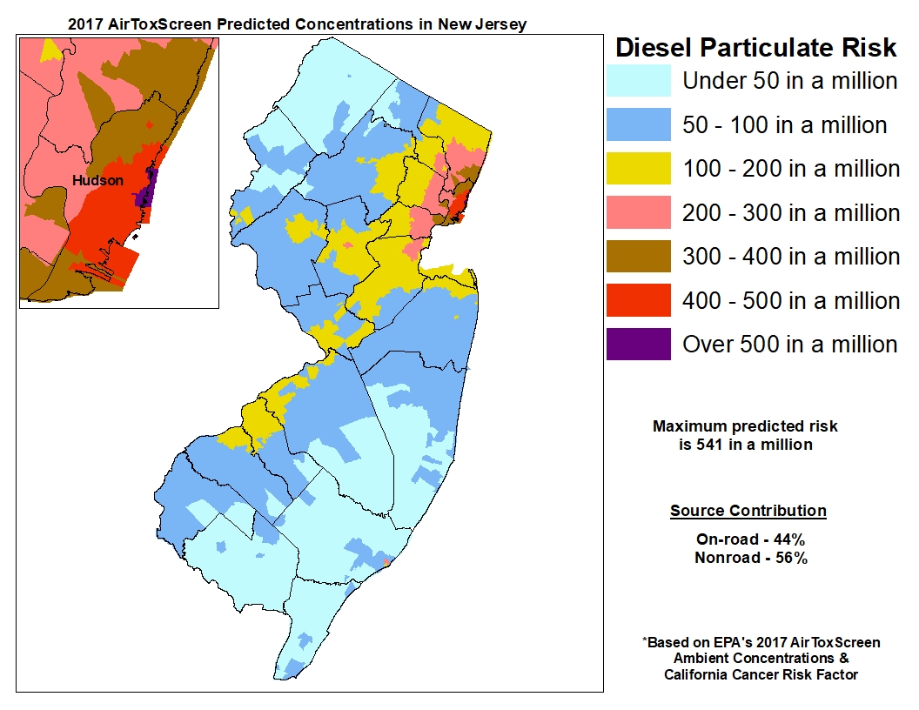

Slide 8
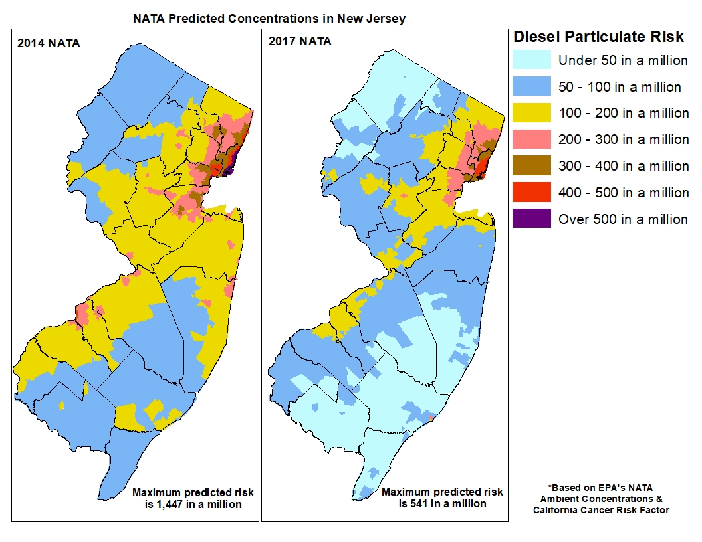

Slide 9
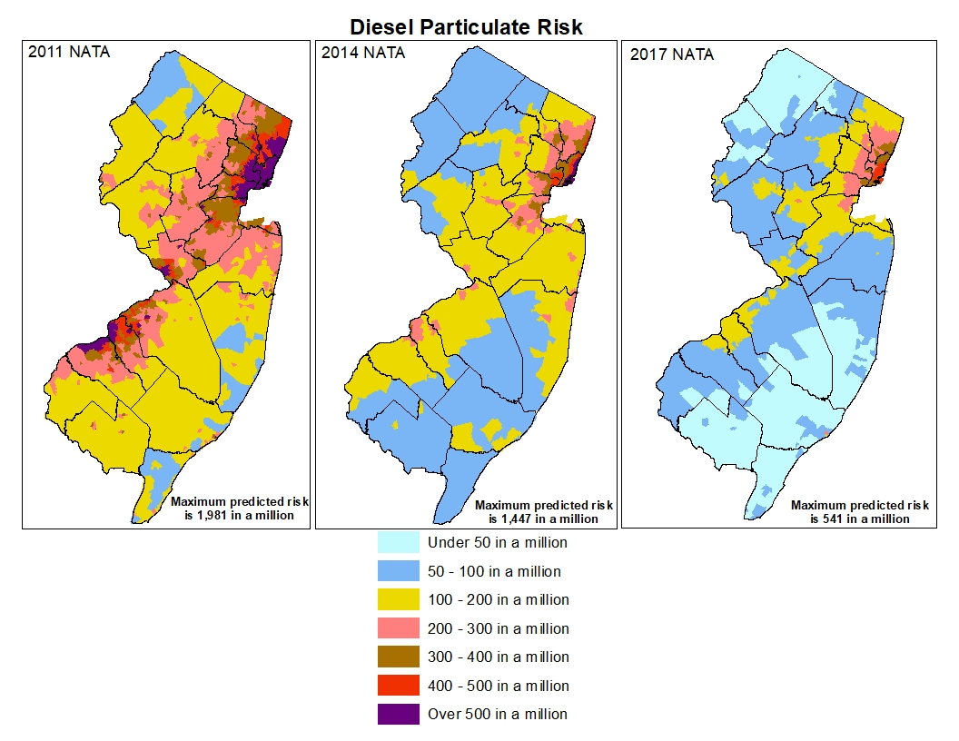

Slide 10
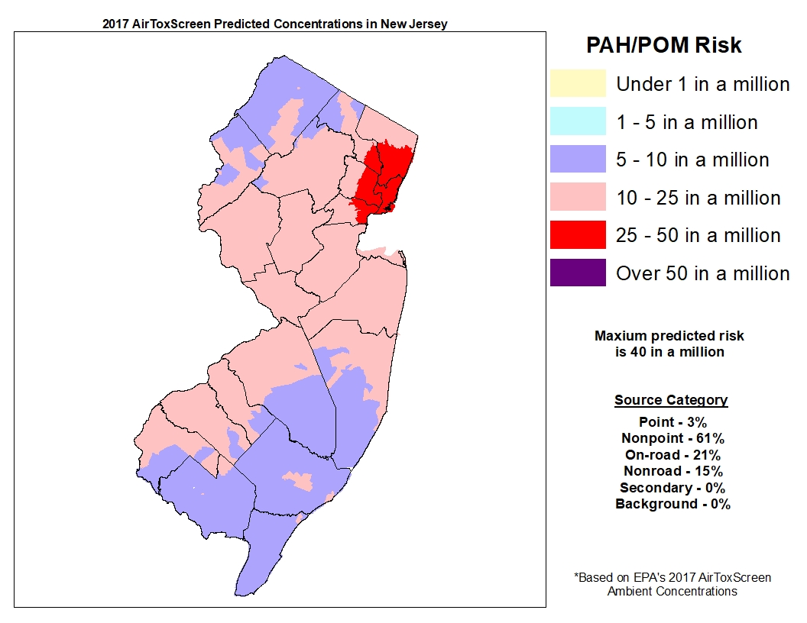

Slide 11
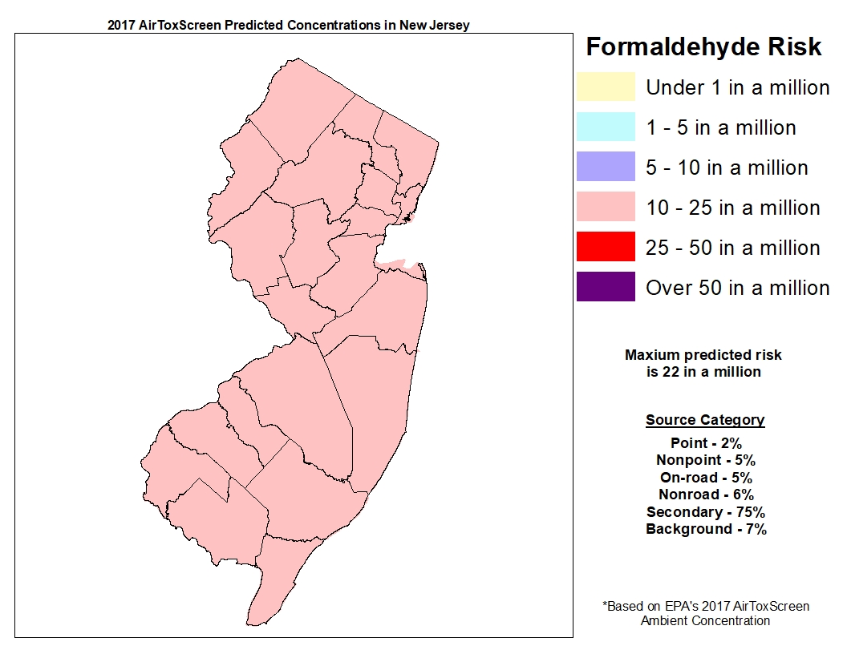

Slide 12
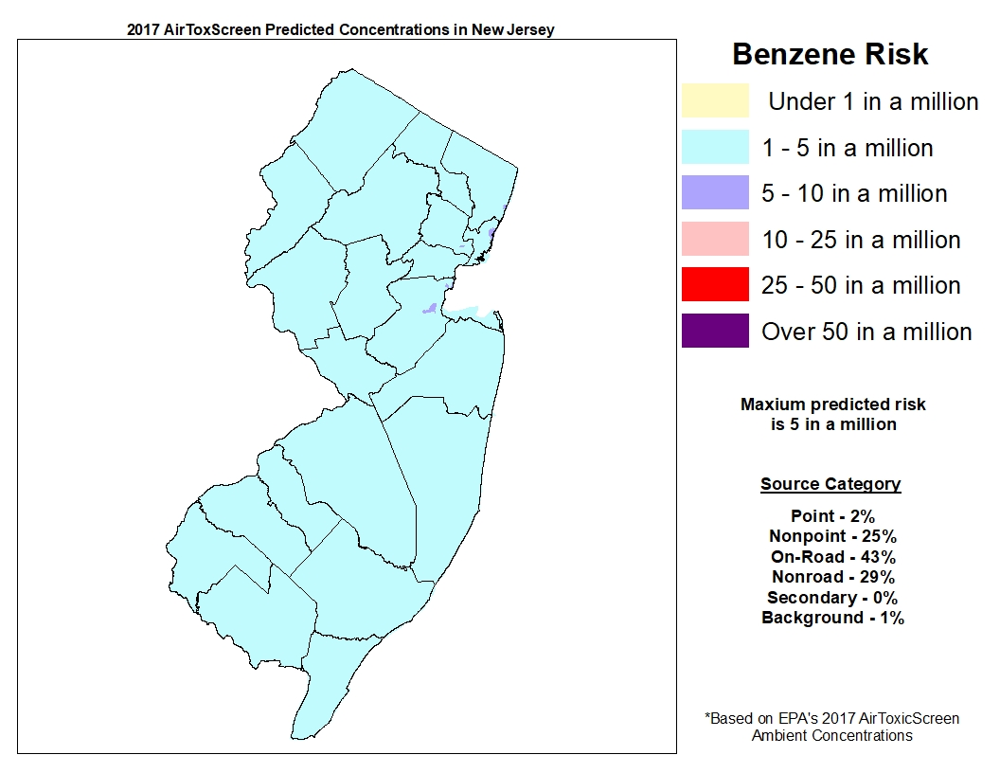

Slide 13
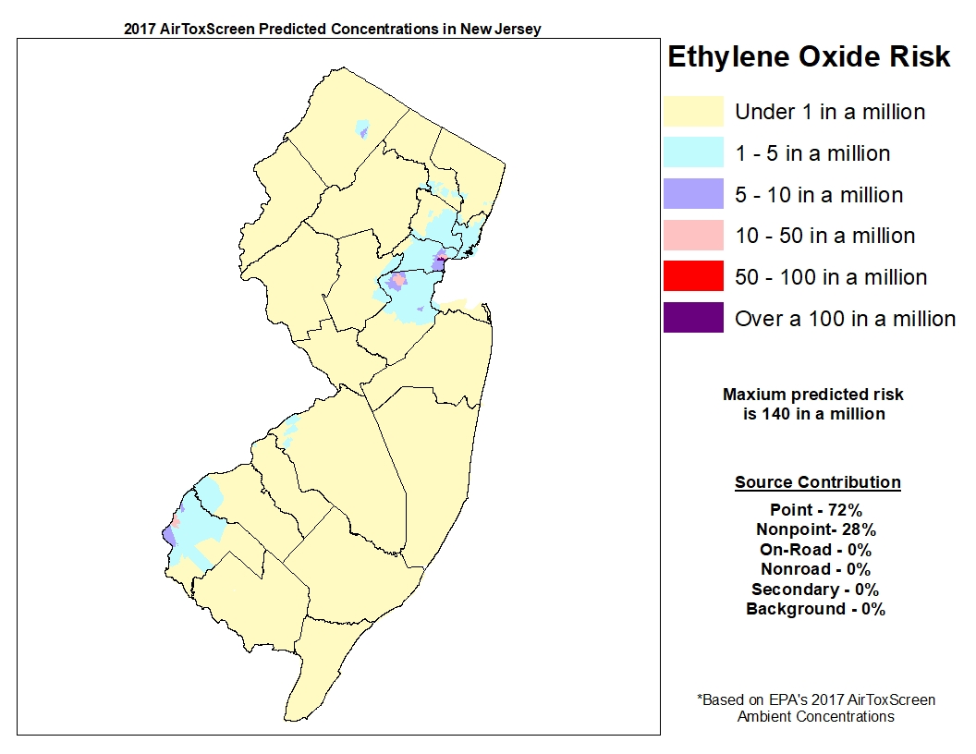

Slide 14
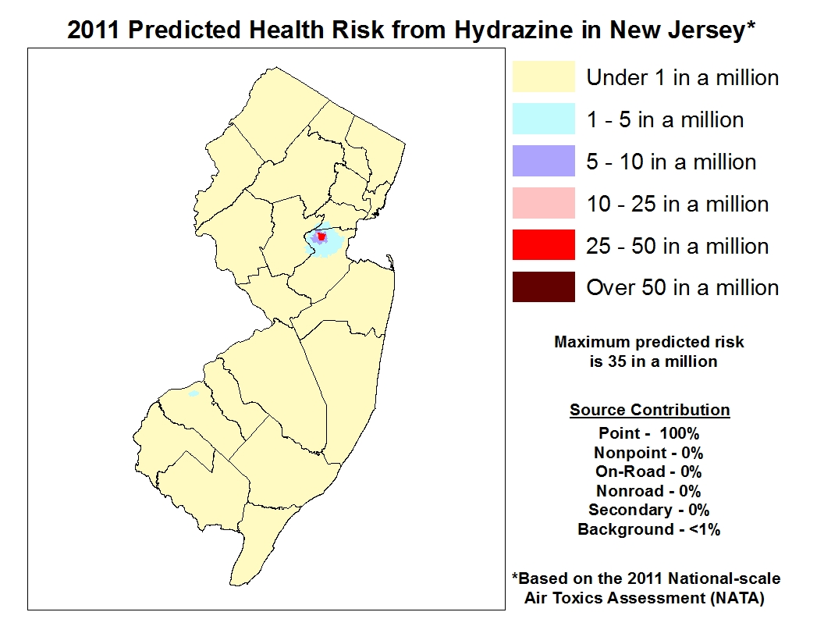

Slide 15
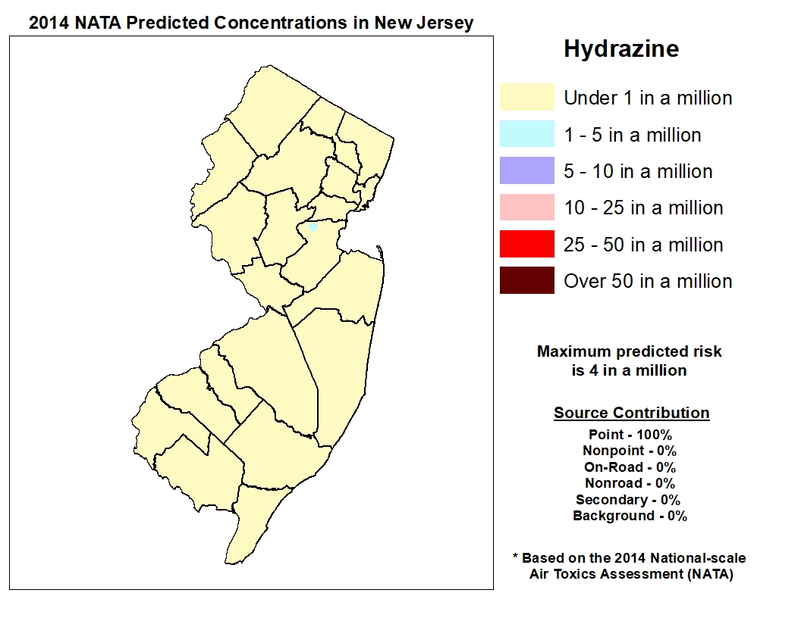

Slide 16
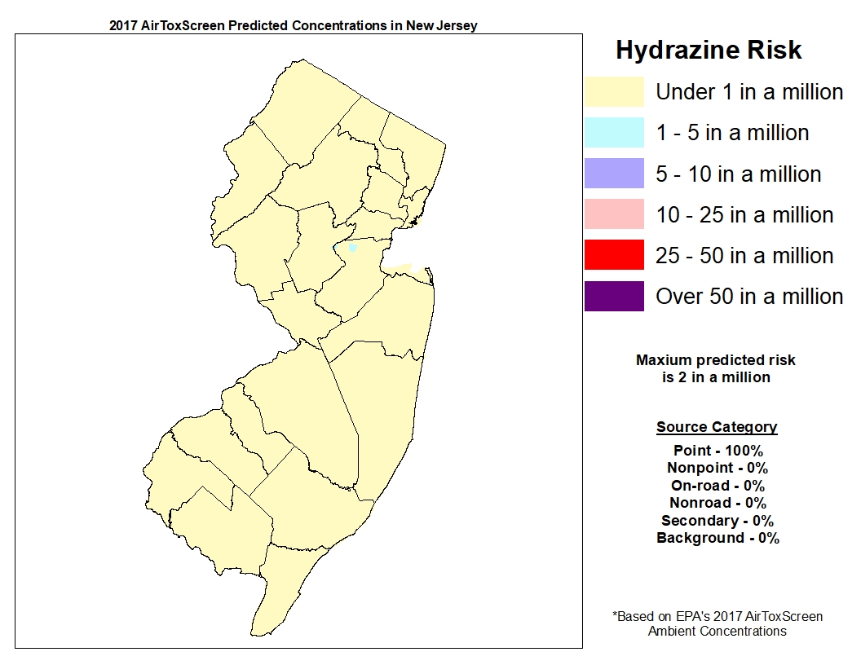

Slide 17
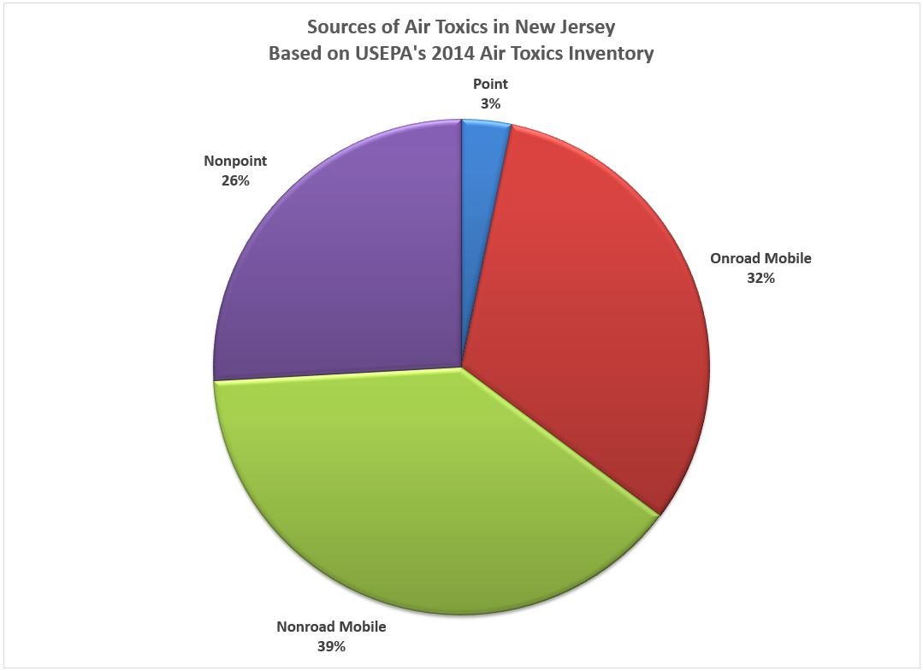
Note: Pie chart based on 2014 emissions data. Waiting on EPA to release 2017 source contribution emissions data.

Slide 18
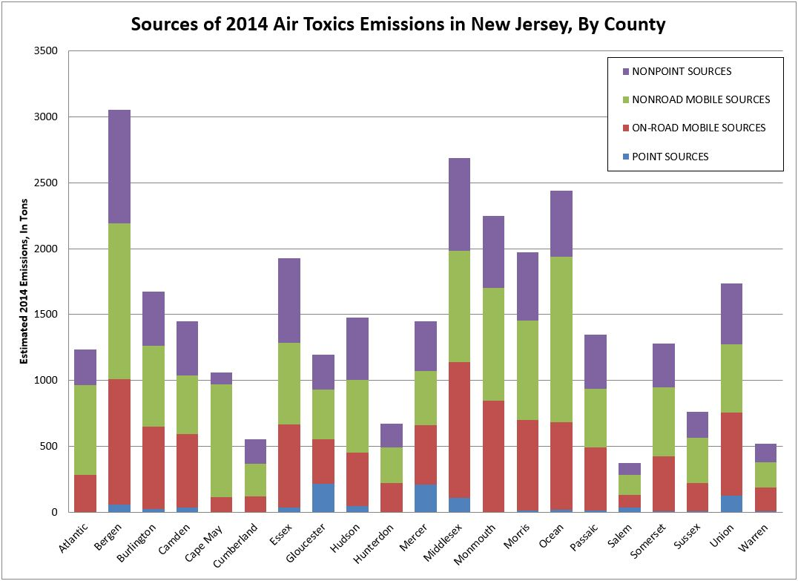
Note: Based on 2014 emissions data.
Waiting on EPA to release 2017 source
contribution emissions data.

