Slide 1
EJSCREEN: Environmental Justice Screening Tool

Slide 2
Background
EPA’s new tool for EJ screening and mapping
Web-based GIS tool and data for EPA and the public
Plan EJ 2014 announced EPA’s plan to create a new, nationally consistent EJ screening tool
Builds upon NEJAC report on EJ screening, and prior work across EPA programs and Regions
Peer reviewed by experts on geospatial tools and EJ

Slide 3
Combines environmental & demographic data
EJSCREEN provides:
1. environmental indicators
2. demographic indicators (predictors of health status and of potential vulnerability to environment) and combines them as an index…
3. “EJ index” for each environmental factor, in each location.

Slide 4
Key Features
12 different environmental factors, including several new or improved metrics (e.g., traffic score)
Updated demographics – every 1 year, not every 10 years
A consistent, quantified approach to EJ, not just “overlays” – numerical indexes that combine environmental and demographic indicators
Accessible and transparent to anyone with a web browser
Standard printable reports and bar graphs
Higher resolution maps – 3 times as many data points
A wealth of additional data maps; can add more from the Web
Raw data downloads will also be available

Slide 5
Using EJSCREEN
A tool for everyone
Available to all EJ stakeholders and general public
But no requirement that state/tribal/stakeholders use it
Basis for further dialogue
EPA uses EJSCREEN in various contexts
Outreach and engagement
Many aspects of environmental programs
Geographically-based initiatives
What does EJ screening show?
Helps show which places may be candidates for further review – where to take a closer look, where to start.

Slide 6
Important Notes About How EPA Uses EJSCREEN
Tool and data to be shared with States, Tribes, public, etc.
Highlights areas that may be candidates for further review
Pre-decisional screening tool
Does not direct final outcomes
Baseline screening should be supplemented with local information and experience
Should not be used to label areas as “EJ community”

Slide 7
Caveats
Demographic and environmental indicators for a single block group may have high uncertainty
Small differences may not be true or meaningful ones
EJSCREEN does not cover all environmental issues.
Other local data and concerns may be very important.

Slide 8
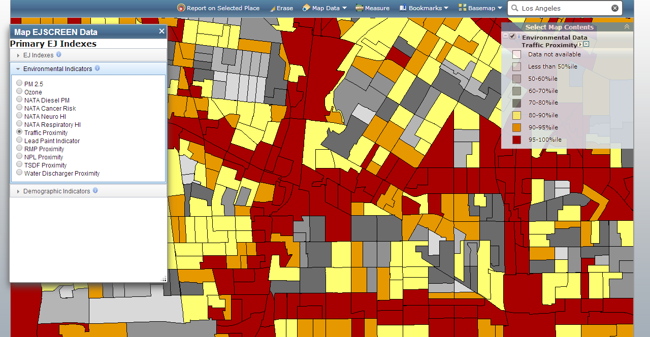
Based on Census Block Groups
Over 217,000 Block Groups in the U.S.
The average block group has a population of about 1,400 residents, and most have between 900 and 1,800 residents.

Slide 9
Twelve Environmental Indicators

Slide 10
12 Environmental Indicators
Environmental Indicator Raw Data Type (Units) | Raw Data Description | Indicator Descriptor
Particulate Matter (PM2.5 in µg/m3) | PM2.5 levels in air, µg/m3 annual average | Potential Exposure
Ozone (ppb) | Ozone summer seasonal average of daily maximum 8-hour concentration in air in parts per billion | Potential Exposure
National Air Toxics Assessment (NATA) Diesel PM in (µg/m3) | Diesel particulate matter (PM) level in air, µg/m3 | Potential Exposure
NATA Air Toxics Cancer Risk (risk per million people) | Excess lifetime cancer risk from inhalation of air toxics | Hazard/Risk
NATA Respiratory Hazard Index | Air toxics respiratory hazard index (ratio of exposure concentration to health-based reference concentration) | Hazard/Risk
NATA Neurological Hazard Index | Air toxics neurological hazard index (ratio of exposure concentration to health-based Reference Concentration (RfC)) | Hazard/Risk

Slide 11
12 Environmental Indicators
Environmental Indicator Raw Data Type (Units) | Raw Data Description | Indicator Descriptor
Lead Paint Indicator (% pre-1960s Housing) | Percent of housing units built before 1960, as indicator of potential exposure to lead-based paint | Potential Exposure
Traffic Proximity (daily traffic count/distance to road) | Count of vehicles (average annual daily traffic) at major roads within 500 meters, divided by distance in kilometers (km) | Proximity
Proximity to National Priority List (NPL) sites (count/km distance) | Count of NPL (Superfund) facilities within 5 km (or nearest one beyond 5 km), divided by distance in km | Proximity
Proximity to Risk Management Plan (RMP) facilities (count/km distance) | Count of RMP (potential chemical accident management plan) facilities within 5 km (or nearest one beyond 5 km), divided by distance in km | Proximity
Proximity to Treatment Storage Disposal Facilities (TSDF) (count/km distance) | Count of TSDFs (hazardous waste management facilities) within 5 km (or nearest one beyond 5 km), divided by distance in km | Proximity
Proximity to Major Direct Dischargers (count/km distance) | Count of NPDES major direct water discharger facilities within 5 km (or nearest one beyond 5 km), each divided by distance in km | Proximity

Slide 12
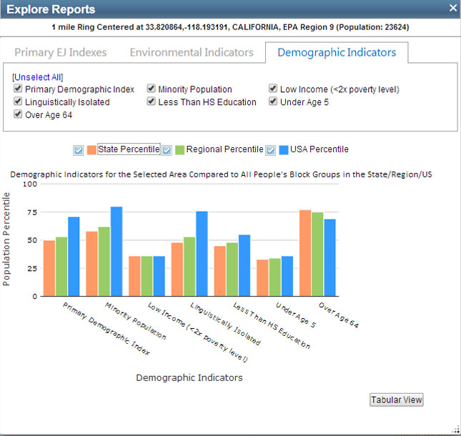
Seven Demographic Indicators
Demographic Index
Minority Population
Low-income
Linguistically isolated
Less than high school education
Under age 5
Over age 64

Slide 13
Demographic Index
Demographic Index
= (% low-income + % minority) / 2

Slide 14
Twelve EJ Indexes

Slide 15
Twelve EJ Indexes

Slide 16
Twelve EJ Indexes

Slide 17
What does the EJ Index mean?
The EJ index combines environmental and demographic data
It shows how much a block group contributes to the nation’s overall disparity (between demographic groups) in that environmental indicator.
In other words,
Nationwide overall, the average low-income and/or minority individual in the US has a higher lead paint indicator score than the rest of the US population.
The EJ index shows how much this block group contributes to that disparity.
If the block groups with the highest EJ index values (for lead paint) were “cleaned up” first, that would be the fastest way to reduce the disparity in average lead paint scores.

Slide 18
Maps – Drilling down to explore one indicator at a time
A Report: Gives you all the indicators at once, for a single, specified location (e.g. within 1 mile of a facility)
e.g., looking at all the indicators for residents nearby
A Map: Gives you one indicator at a time, for each of the block groups within a wider area (e.g. across several miles)
e.g., for a single indicator like lead paint, exploring and prioritizing hot-spots, or drilling down from a report to compare neighborhoods or small communities

Slide 19
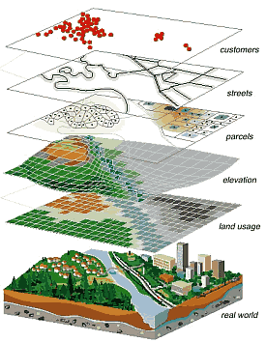
EJSCREEN PROVIDES MANY OTHER MAP FEATURES
The mapping tool adds many other types of data by overlaying various datasets (called “layers”)

Slide 20
EJSCREEN Overview
Questions?

