Slide 1

Midterm Evaluation of Light-Duty Vehicle
Greenhouse Gas Emissions Standards for Model Years 2022-2025
Final Determination
Briefing for NACAA Mobile Sources Committee
January 24, 2017

Slide 2
Overview
EPA’s Final Determination
Common Myths/Realities about the GHG/fuel economy program

Slide 3
Midterm Evaluation &
EPA’s Final Determination

Slide 4
The MTE Process
In the 2017-2025 rulemaking, Agencies committed to a midterm evaluation of 2022-2025 standards
  Coordinated review with EPA, NHTSA, and California ARB
  Holistic assessment of all the factors considered in setting standards
Through the MTE, the EPA Administrator must determine the appropriateness of the 2022-2025 standards
EPA regulations set forth a 3 step process:
  Draft Technical Assessment Report (TAR) – issued jointly with EPA, NHTSA, CARB for public comment in July 2016
  Proposed Determination on whether the 2022-2025 standards are appropriate – issued by EPA Administrator for public comment in November 2016
  Final Determination – signed by EPA Administrator on January 12, 2017

Slide 5
EPA’s MTE assessments informed by a wide range of information
Technical research initiated by EPA
    Benchmarking testing of 30 vehicles across wide range of powertrains & segments
    Published more than 30 peer-reviewed papers and technical reports
    Vehicle simulation modeling, cost teardown studies, mass reduction feasibility/cost studies, manufacturer “learning by doing” costs, research on consumer issues, economic inputs, others
Extensive reviews of the literature
    Including significant studies such as the 2015 National Academy of Sciences report
Stakeholder outreach & collaboration
    Hundreds of meetings with automakers, suppliers, NGOs, consumer groups, labor, states/local governments
    Collaboration with NHTSA, CARB, DOE, Canada

Slide 6
EPA’s Final Determination on
MY2022-2025 Standards
On January 12, 2017, the EPA Administrator signed a Final Determination finding that the MY2022-2025 standards remain appropriate under the Clean Air Act
EPA extensively assessed public comments on the Proposed Determination, and responded in a 174-page Response to Comments document
This action concludes the Midterm Evaluation under EPA’s regulations

Slide 7
Key Findings
Standards are feasible and cost-effective, with a wide range of technology pathways available
Standards will achieve significant GHG and oil reductions
Standards provide significant benefits to consumers and the public
The Administrator also noted that the record could support more stringent standards. Recognizing the importance of regulatory certainty for the industry’s long-term planning, she concluded that it is appropriate to provide the full measure of lead time for the current standards, rather than proposing to adopt more stringent standards with shorter lead time.

Slide 8
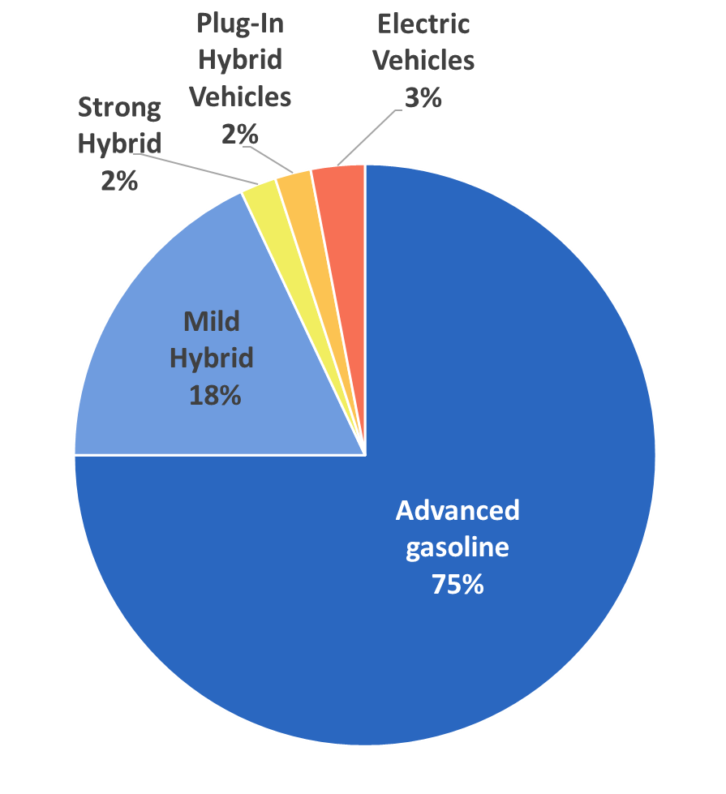
2025 Standards can be met mostly with advanced gasoline vehicle technologies*
Advanced engines and transmissions
Vehicle light-weighting
Improved aerodynamics
More efficient accessories
Low rolling resistance tires
Stop-start technology
Mild hybrid (e.g., 48 volt systems)
* Consistent with findings of the 2015 National Academies of Sciences report

Slide 9
Standards will achieve significant benefits*
  Standards will achieve significant GHG and oil reductions
      Reduce GHG emissions by 540 MMT and oil consumption by 1.2 billion barrels over lifetime of MY2022-2025 vehicles
  Standards provide significant benefits to consumers and the public
      Net societal benefits of nearly $100 billion
      Net lifetime consumer savings of $1,650
      Payback for an average MY2025 vehicle (compared to MY2021):
          Consumers who finance with 5-year loan will see payback within 1st year
          Consumers who pay cash will see payback within 5 years
* All analyses compare the MY2022-2025 standards to a reference case of the MY2021 standard

Slide 10
Beyond MTE – expected further interactions on LD Vehicle GHG program
Harmonization
    EPA will continue coordinating with NHTSA and stakeholders to respond to issues raised in a June 2016 auto industry petition regarding several areas they believe will improve harmonization across the GHG and fuel economy programs (e.g., off-cycle technologies and other credit provisions)
Advanced Vehicle Incentives
    Comments on the Proposed Determination spoke to the need for additional incentives or flexibilities in the out years of the program, including incentives for electric vehicles
    EPA is open to further dialog with stakeholders on ideas that could incentivize and promote market for advanced technology vehicles (e.g., EV/PHEVs, fuel cells)

Slide 11
Myths vs. Realities

Slide 12
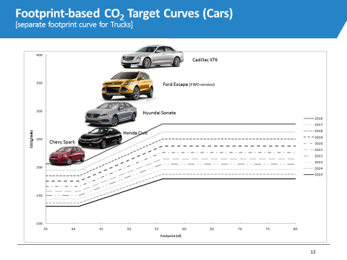
MYTH: Low gas prices & more SUVs make it harder for automakers to comply
REALITY: Standards adjust to reflect the types of vehicles consumers buy. Automakers can comply with any mix of vehicles.

Slide 13
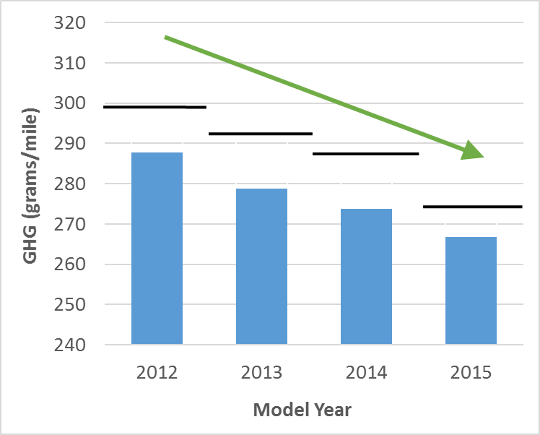
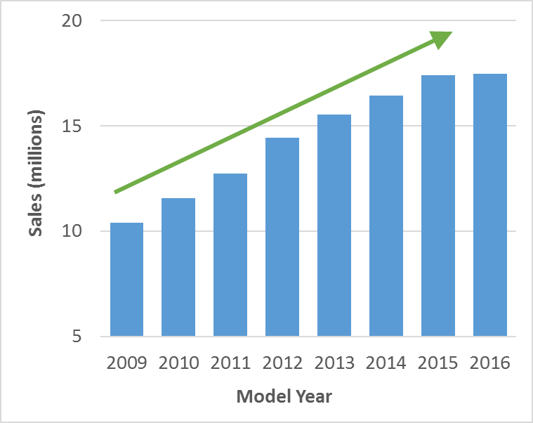
Standards are Working
Automakers Outperforming Standards
7 Years of Sales Increases Thru 2016
First Time in 100 Years

Slide 14
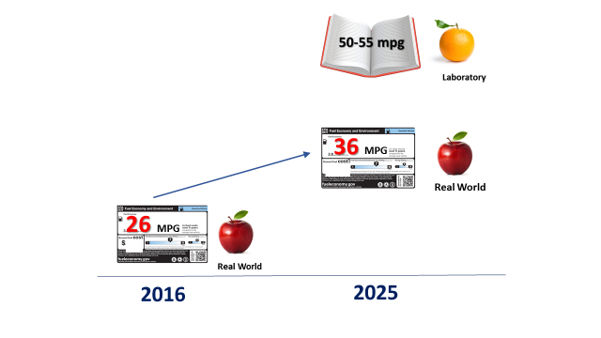
MYTH: 54.5 mpg is too big a lift
REALITY: Automakers need to get just +10 mpg in the next 8 years

Slide 15
Fuel Prices/Fleet Mix Affect Projected CO₂ Levels
Projections for 2025
Projections for 2025 | 2012 Final Rule | Proposed Determination
 | AEO 2011 Reference | AEO 2016 Reference | AEO 2016 Low | AEO 2016 High
Fuel price¹ ($/gallon) | $3.87 | $2.97 | $1.97 | $4.94
Car/truck mix | 67/33% | 53/47% | 44/56% | 63/37%
CO₂ (grams/mile) | 163 | 173 | 178 | 167
MPG-e² (2-cycle compliance) | 54.5 | 51.4 | 49.9 | 53.3
Real world
36 MPG
(233 g/mi)
¹AEO 2011 fuel price is 2010$ (equivalent to $4.21 in 2015$); AEO 2016 fuel prices are 2015$.
² Mile per gallon equivalent (MPG-e) is the corresponding fleet average fuel economy value
if the entire fleet were to meet the CO₂ standard compliance level through tailpipe CO₂ improvements that also improve fuel economy.; provided for illustrative purposes only.
Source: EPA Final Determination, Table ES-2

Slide 16
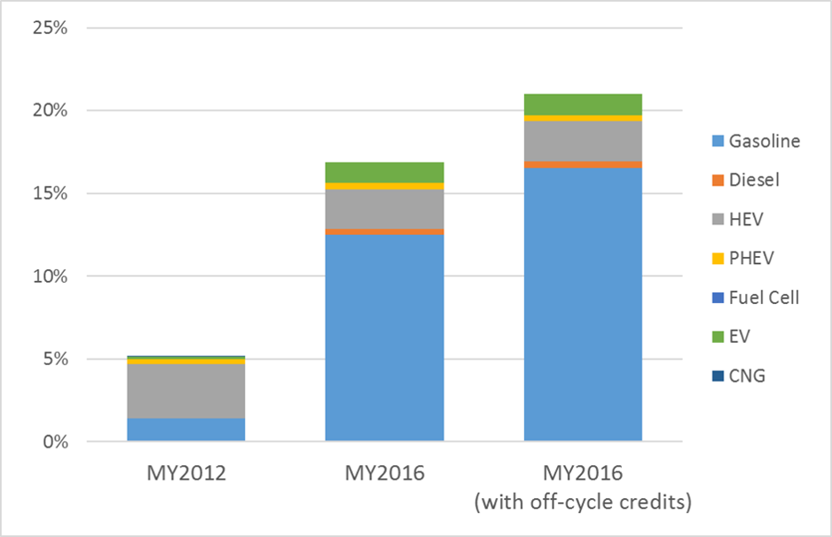
MYTH: Gasoline vehicles can’t get us to 2025
REALITY: Many gasoline vehicles are already meeting 2020 standards, and some best-selling vehicles are already close – with 8 years to go
Vehicle Production Meeting MY2020 Targets
In just
4 years
Source: EPA Proposed Determination Technical Support Document, Appendix C, Figure 3.1
Note that with fleet averaging, in any given model year, only about 50% of vehicles would need to meet their target, depending on sales volumes

Slide 17
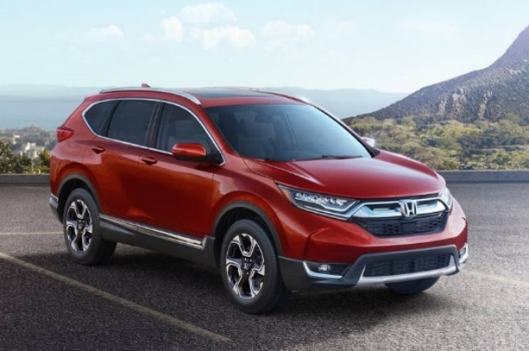
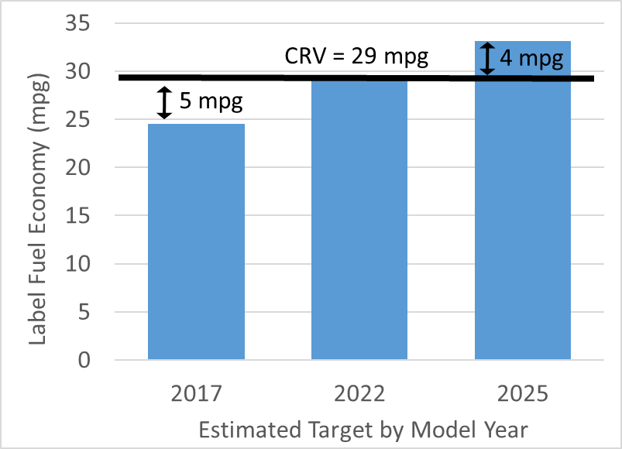
Case Study:
2017 Honda CRV 1.5 L AWD
Best-selling SUV in U.S.
AWD versions make up 2/3 of sales
Advanced Gasoline Technology:
  Turbocharged 1.5 liter I4 engine
  Continuously variable transmission
  No electrification
Already meets* 2022 target
  5 years ahead
Within 4 mpg of 2025 target
  With 8 years to go
*
*Illustrative example only. EPA estimated real-world fuel economy targets from
CO₂ compliance targets, assuming A/C credits and 5 g/mi off-cycle credits

Slide 18
Thank You!
Robin Moran, Senior Policy Advisor
U.S. EPA, Office of Transportation and Air Quality
Robin Moran, EPA/OTAQ
moran.robin@epa.gov; (734) 214-4781
EPA’s MTE web site:
https://www.epa.gov/regulations-emissions-vehicles-and-engines/midterm-evaluation-light-duty-vehicle-greenhouse-gas-ghg

