Slide 1
Multi-Pollutant Risk-Analysis & Reduction Strategy for South Carolina
NACAA Update
June 22, 2016

Slide 2
Background
Collaborative effort between EPA, SC DHEC, and the local air coalition “Clean Air Upstate” (CAU) with participation from community and business leaders in ten SC upstate counties (known as Ten at the Top (TATT)) to develop and analyze a multi-pollutant, risk-based air quality management strategy.
Goal was to identify and evaluate a local control strategy to reduce both ozone and PM2.5 precursor emissions as well as target emissions of air toxics of concern for communities to maximize both health benefits and air quality improvements.
Local emission reduction measures for the Upstate that address multiple pollutants were identified by DHEC, EPA, and CAU/TATT.
Started under the Advance program and focused on the upstate due to the impending 2015 ozone NAAQS and the local coalition’s commitment to air quality.

Slide 3
Project Details
Control measures and their costs were identified.
Air quality modeling was conducted to assess emission reduction effects on ozone, PM2.5, and other pollutants.
Population risk exposure was assessed using the 2011 National Air Toxics Assessment (NATA) and Benefits Mapping and Analysis Program – Community Edition (BenMAP–CE).

Slide 4
Control Strategy Analysis
Focused only on non-EGU point and area sources and did not include mobile sources.
Maximum emissions reductions method was chosen to see what is potentially available in terms of controls and emissions reductions. Conducted a max controls CoST run “robust strategy.”
Also included local CAU/TATT Strategies: 1) new gas stoves and gas logs and 2) open burning curtailment (both included in the CoST run). Anti-idling was also evaluated as a local control measure, but was analyzed by DHEC separately.
Notes:
Mobile sources not included due to the difficulty in regulating mobile source emissions from a state perspective and because of the added project resources that would have been required to run SMOKE-MOVES

Slide 5
Control Measures
Area Sources
Point Sources
Low NOx Burner (1997 AQMD)
RACT to 25 tpy (Low NOx Burner)
Low NOx Burner
Water and Space Heaters
Curtailment Program, aka “Burn Ban”*
New gas stove or gas logs*
Control Technology Guidelines
LPV Relief Valve
Motor Vehicle Coating MACT
Process Modification
Reformulation (OTC Rule)
Reformulation (Phase II)
Reformulation-Process Modification
Reformulation-Process Modification
(OTC Rule)
Solvent Utilization
Low Emission Combustion
Low NOx Burner
Selective Catalytic Reduction
Dry Injection / Fabric Filter System (DIFF)
Wet Scrubber
Add-on controls, work practices, and material reformulation/substitution
Permanent Total Enclosure (PTE)
Solvent Recovery System
Notes:
A notable NOx reduction strategy was “low emission burning” to point sources that cost ~$650/ton and lead to a 1065 tpy reduction in NOx. Low NOx burner point source reduction was ~$6500/ton and reduced NOx by only 192 tons. The Dry Injection/Fabric filter system costs $13,000/ton of PM2.5

Slide 6
Control Strategy Reductions
The breakdown for reductions by pollutant was:
NOx: almost 1,600 tons reduced (of ~46,000)
Primary PM2.5: about 200 tons reduced (of ~8,000)
SO2: almost 800 tons reduced (of ~8,700)
VOC: almost 3,000 tons reduced ( of ~46,453)
Notes:
NOx – 1,587 tons (of 46,179)
PM2.5 – 222 tons (of 7,943)
SO2 – 766.32 tons (of 8,725)
VOCs – 2,727 tons (of 46,453)
( ) –total emissions of each pollutant in 10 counties
Based on 2011 NEI

Slide 7
Control Strategy Costs
Total costs for this strategy was ~$20 million ($2011):
The breakdown for this cost by pollutant was:
NOx at $2 million (10% of total cost)
Primary PM2.5 at $2 million (10% of total cost)
SO2 at $3 million (14% of total cost)
VOC at $13 million (66% of total cost)
The breakdown by sector was:
Non-EGU point sources: almost $8 million (40% of total cost)
Non-point sources: $12 million (60% of total cost)
The effectiveness of the NOx control measures varied widely based on the cost which ranged from ~$300-$13,000 per ton of emissions reductions.

Slide 8
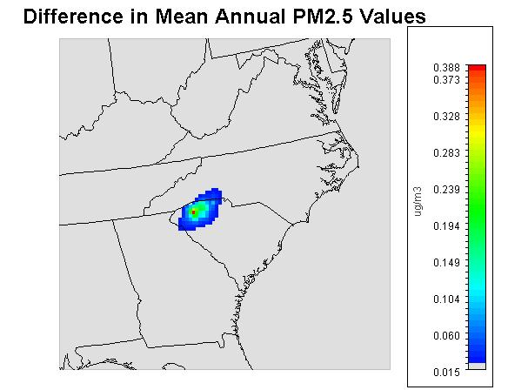
Results – PM2.5
Notes:
This is the mean annual difference between base and test case. Reductions are around .1-.4 ug/m3 reduction. Around a 2% reduction.
The biggest reductions occurred in the colder months in the organic carbon species. wood to natural gas control strategy likely had a lot to do with this temporal and species reduction profile. Organic carbon sources are usually wood combustions. Results, taken together indicate that the wood stove conversion to
natural gas reduction strategy may be effective at reducing annual PM2.5 emissions.

Slide 9
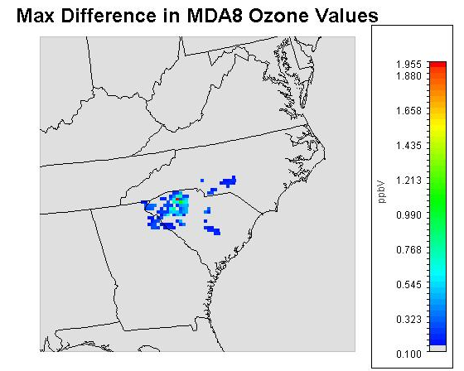
Results - Ozone
Notes:
Reduction was from a base case 2011 compared to a test case. This illustration is the difference in the maximum 8-hour daily max concentration between the 2. there was a max reduction in one cell of ~2 ppb, but most of the area saw less than a 1 ppb reduction in ozone. Again, this is the max difference. The form of the standard is 4th high. Less than a 1% reduction.

Slide 10
Upstate NOx Emissions by Source Category
Notes:
NOx is the main driver of ozone in the area, and 77% of NOx is from mobile sources (onroad and nonroad).

Slide 11
2011 NATA Cancer Risk – SC TATT Counties Pollutant Contributions (47 in a million)

Slide 12
Approach to Estimate Air Toxic Risk Reductions
Based on the 2011 NEI, 28,000 tons of air toxics are emitted each year from the SC TATT counties.
Apply countywide percentage reductions from TATT inventory to NATA point and nonpoint risk results on a pollutant-by-pollutant basis.
Reductions only for point and nonpoint sources, which contribute only about 5% to the total risk in the TATT counties (Secondary, mobile, and biogenics are over 80%).
Limitations:
Assumes reductions equal across all NATA point and nonpoint source categories.
Based on 2011 NATA.
Most of the risks are from secondary formed pollutants (mainly formaldehyde), so reduction efforts to reduce precursors such as nitrogen oxides and other criteria pollutants would have a co-benefit in reducing risks from air toxics.

Slide 13
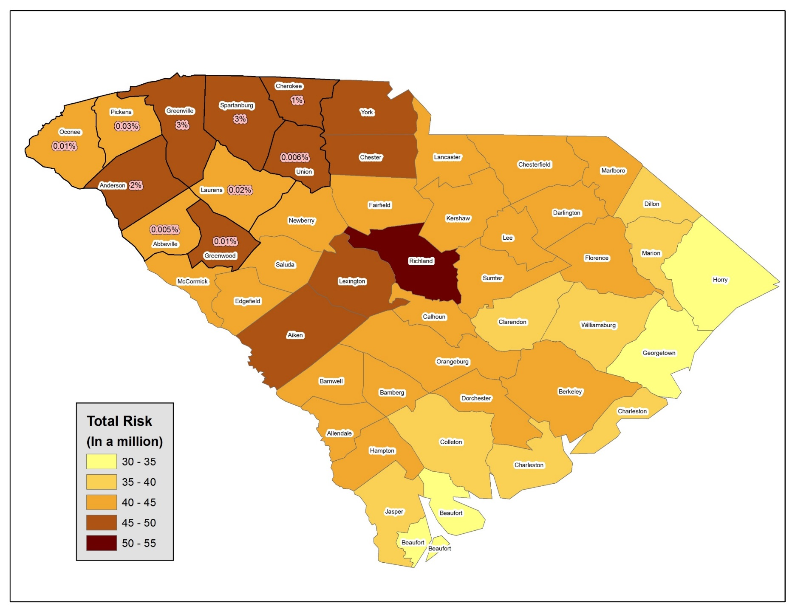
Final 2011 NATA Expected % Cancer Risk Reductions - SC TATT

Slide 14
Cost-Benefits Analysis (Millions of 2010 Dollars)
Total Air Quality Benefits | PM_{2.5} | Ozone
Maximum Air Quality Change in any TATT County¹ | 0.251 µg m⁻³ | 0.106 ppb
Total Control Strategy Cost | $20
Total Benefits of Avoided Mortality and Morbidity (PM: Krewski-Lepeule; Ozone: Bell-Levy) | $92-220 | $3.1-4.4
Net Total Benefits | $82-210
Benefit-Cost Ratio | 4.1-10
¹The maximum change for PM_{2.5} is expected at Greenville County, SC;
the maximum change for ozone is expected at Spartanburg County, SC

Slide 15
Avoided PM-Related Deaths
Lepeule et al. study for 25-99 year olds

Slide 16
PM Benefits and Valuation Summary (Millions of 2010 Dollars)
 | TATT | South Carolina | Modeling Domain
Population | 930,000 | 3,000,000 | 43,000,000
PM Avoided Deaths (Krewski and Lepeule) | 10-23 | 11-24 | 16-36
PM Benefits (Peters, 3% Discount) | $92-210 | $97-220 | $140-320
Ozone Avoided Deaths (Bell, 2004) | <1 | <1 | 1.0
Ozone Benefits (Bell, 2004 + Morbidity) | $3.2 | $4.3 | $10
Total PM and Ozone Benefits (95% Confidence Interval) | $95 ($9.3-260) | $101 ($9.8-270) | $150 ($15-420)

Slide 17
Conclusions
Improving air quality in areas already attaining the NAAQS can yield significant health and associated costs benefits.
Mobile source reductions should be an area of focus for reduction strategies in the future in this area since mobile source emissions contribute significantly to NAAQS and air toxics levels.
Reduction efforts to reduce precursors such as nitrogen oxides
and other criteria pollutants can have a co-benefit in reducing risks from air toxics.
Implementing local control strategies in an area with a mix of sources is an important component of successful air quality management programs. In light ever decreasing standards, we will rely on local governments and coalitions to pursue proactive transportation strategies that reduce pollutants…because creating nonattainment strategies will be difficult.

Slide 18
Lessons Learned
Local area perspective and expertise play a large role in successfully implementing any voluntary emissions reduction program.
Project allowed for knowledge transfer and feedback. CAU supports the development of tools and resources for local coalitions aimed at allowing them to easily understand the effect that certain activities will have on air quality and various pollutant levels. This analysis is helpful in determining whether programs (like Breathe Better at Schools) and their financial costs are supported by the likely outcomes.
When EPA and state partners work together closely, it’s possible to gather and use the data needed for the benefits analysis. Helpful information can be gathered from even a moderate amount of data.
Notes:
While the air quality benefits of local strategies may not show an air quality benefit when a broader-scale attainment demonstration for a SIP is conducted, this
risk-based analysis demonstrates that local regulatory and voluntary control measures are an important part of an air quality management program. By using a multi-pollutant approach, some strategies with multi-pollutant benefits might not have been considered if pollutants had been examined one at a time; a strategy that might seem too expensive to reduce a single pollutant or too difficult to implement might emerge as cost-effective once all the cobenefits are factored into the analysis.
The EPA staff also benefited from feedback from South Carolina on the CoST database and how to reflect local conditions in the tool with more accuracy and
from the opportunity to deliver BenMAP-CE training to South Carolina staff, which prepared them for subsequent domestic and international training classes. Through the collaborative working relationship, EPA was able to train a new staff member in how to run the tool with location-specific health data.

