Slide 1
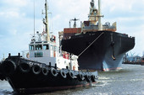
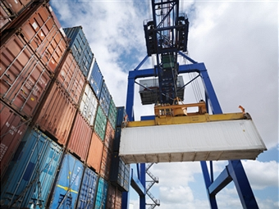
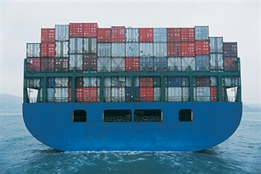
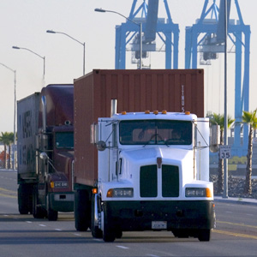
EPA Ports Initiative Recommendations to the Environmental Protection Agency NACAA Briefing Oct. 25, 2016 Lee Kindberg, Maersk Line

Slide 2
Port-related operations are significant sources of air emissions and greenhouse gases.
Many ports are in areas with existing air quality challenges and nearby populations.
The largest sources of port-related emissions are vessels and trucks.
Notes:
Million of people live near ports and rail yards, including a disproportionate number of low-income households, African-Americans, and Hispanics
Trade is growing, and port expansion projects are underway.
Emission reduction technologies and strategies have been slow in implementation
NON-ATTAINMENT IS JUST ONE INDICATOR OF AIR QUALITY AND IMPACTS
Based on GIS data, approximately 40% of “Principal Ports” were located in or near current nonattainment or maintenance areas (see Figure below).
However, nearby community and worker exposure to diesel emissions can occur at all ports.
The map was based on a comparison of GIS data on the Army Corps of Engineer’s 2014 list of 150 “Principal Ports” and EPA’s latest NAAQS designations. Nonattainment and maintenance area maps reflect the latest EPA NAAAQS for all pollutants

Slide 3
“Ports” are complex legal & operational systems.
Port Authority
Government-established entity
May be “Landlord,” Operating or both
Financial and legal responsibilities
Environmental requirements for expansions, changes and as needed due to policies, or by government or tribal agencies programs.
Some have or are developing environmental strategies, inventories and programs
The “convening” entity
Other port operators
Marine terminals (cargo and passenger)
Private terminals, Pilots, tugs and harbor craft
Energy and fuel suppliers
Dredging/maintenance/construction
On/near-port railyards and warehouses
Satellite port facilities
USCG, CBP and other governmental entities
(On-port manufacturing was excluded from study)
Port facility visitors/users
Ocean/lake/river-going vessels and barge services
Rail carriers
Trucking companies
Supply deliveries
Workers for all entities
Passengers
Military vessels may/ay not be included
Others impacted
Surrounding community and tribes
Other governmental entities (federal, state, local and tribal)
Cargo owners, shippers and recipients
Marine or land-based ecosystems
Fishermen, offshore oil and suppliers, recreational users

Slide 4
EPA’s Port Initiative
Vision: To develop and implement an environmentally sustainable port strategy that:
identifies opportunities and finds solutions to help build a more sustainable ports system
creates healthy air quality for communities
reduces climate risk
National Conversation on Ports (Webex)
Sept 24, 2013 – Promoting Port Stakeholder Success
Industry stakeholders showcased successes & challenges
Jan 14, 2014 – Collaborative Solutions & Community
Scientists and community groups discussed experiences, concerns and lessons learned about port impacts
Mar 4, 2014 – Advancing Sustainable Solutions
Stakeholder perspectives on assessing port emissions, technical solutions and lessons learned
Port Stakeholders Summit
Summit held April 8, 2014 in Baltimore
215 experts and stakeholders attended
Purpose: to continue dialogue and build momentum through face to face interaction with stakeholders
Goals:
Exchange information and insights
Take a deeper dive into the challenges and solutions
Build and strengthen collaboration

Slide 5
US EPA Ports Initiative Workgroup Established Summer 2014
EPA asked their mobile sources advisory group (MSTRS*) for recommendations on:
Development of an EPA-led voluntary environmental port initiative
How to effectively measure air quality and GHG performance of ports and/or terminals within ports
Considerations:
“Ports” includes all the operators that move cargo in and out of ports – not just the Port Authorities.
Existing port and port-related environmental improvement programs
Ports in the context of the broader transportation supply chain
Previous studies/recommendations and other relevant programs
* MSTRS is the Mobile Sources Technical Review Subcommittee of the US EPA’s Clean Air Act Advisory Committee (CAAAC)

Slide 6
Process
Next Steps
Report has been finalized and published on the CAAAC and EPA Ports Initiative websites
35 specific recommendations in 6 program areas
106 page report
Glossary of shipping & environmental terminology
An Addendum includes the MSTRS letter and CAAAC member comments.
Implementation planning is already underway in the EPA Office of Transportation Air Quality (OTAQ)
A Workgroup of experts and a range of stakeholders was assembled
Subgroups assessed needs/opportunities and developed recommendations
The Port Initiative Workgroup worked to create a report that reflects the viewpoints of all Workgroup members. Where opinions differed on particular recommendations, the differing points of view are discussed, and these recommendations are identified with an asterisk (*).
One idea was considered out-of scope or non-consensus (Section 9).
Approval
Workgroup leaders reported regularly to MSTRS and CAAAC throughout the process
MSTRS presentation and approval June 16, 2016, with letter to CAAAC
CAAAC unanimously approved the report on Sept. 7, 2016 and sent to the US EPA Administrator as their formal recommendations
Notes:
The Workgroup first met on August 19, 2014 in Baltimore and has had 4 face-to-face meetings to date. Over the course of these meetings, the Workgroup decided to form 6 subgroups to focus on the common themes and critical areas of discussion. Some subgroups convened via telephone as much as bi-weekly.
We have reported regularly to MSTRS and occasionally to CAAAC throughout the process, and received valuable feedback and discussion from MSTRS at the port-focused meeting in Long Beach in December 2015.
We have some recommendations that are not full consensus, but differences were a matter of degree or approach. In these cases we have discussed the differences to provide guidance to the Agency.
Section 9 language
There were extensive opportunities for input and comment. Subgroup drafts → draft recommendations with discussion and comments (iterative). Review opportunities to comment. Then overall report with written and verbal comment opportunities and we held “office hours” and individual calls with community representatives.

Slide 7
EPA Ports Workgroup Members
Co-chairs: | Lee Kindberg, Maersk Line, and Sarah Froman, EPA
Ports: | Maryland, Charleston, Long Beach, New Orleans, Virginia
Terminals: | Ports America
Shippers: | Cargill, Walmart, HP
Equipment: | Caterpillar, Manufacturers of Emission Controls Association
Rail: | Burlington Northern Santa Fe
Trucking: | Evans Delivery
Port Community Advocates: | East Yard Communities for Environmental Justice, Southeast CARE Coalition, Steps Coalition
Tribes: | Fond du Lac Air Program
NGOs: | Environmental Defense Fund, Natural Resources Defense Council
Research/analysis: | International Council on Clean Transportation
Government: | New Jersey DEP, SC DHEC, MARAD, CMTS
Non-voting: | American Association of Port Authorities, StarCrest (B. Anderson)
EPA Support | Office of Transportation Air Quality (OTAQ), Office of Environmental Justice, Office of Water Region 1, Region 2, Region 6, Region 9
Notes:
The MSTRS Ports Workgroup includes representatives from marine shippers, ports, terminal operators, beneficial cargo owners, technology experts, rail, trucking, environmental groups, state environmental agencies, tribal representation, and community groups.
In addition we have included other federal agencies (MARAD and CMTS) and internal EPA offices (OW and OEJ) plus the regions. Region 2 as sub-lead for mobile sources is coordinating regional engagement with MSTRS.

Slide 8
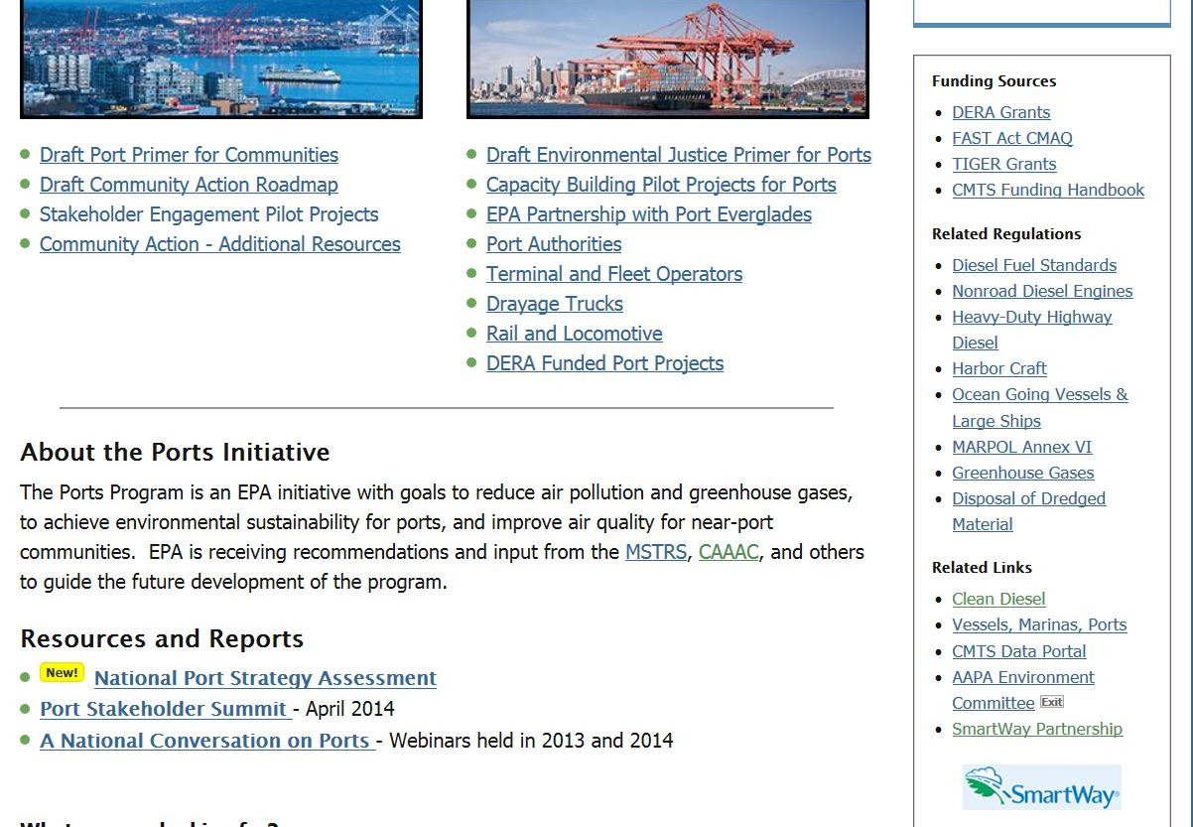
https://www.epa.gov/ports-initiative https://www.epa.gov/sites/production/files/2016-09/documents/ports_workgroup_report_for_epa_9_15_16.pdf

Slide 9
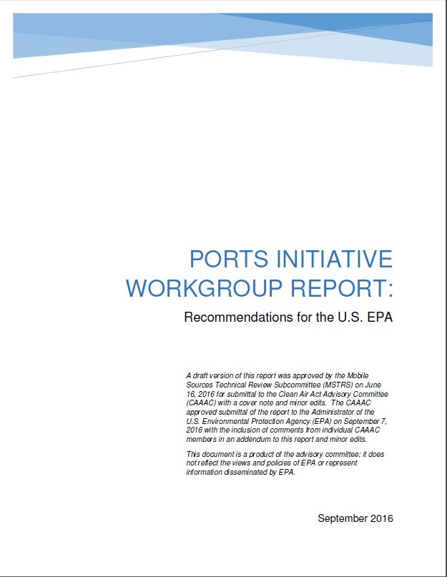
Recommendation: EPA should establish a voluntary ports environmental performance program.
“PACE: Port Action for a Clean Environment”
Intent: Drive continuous improvement by
providing access to resources and tools,
sharing expertise on freight and passenger movement and port-related health impacts,
better aligning federal agency programs and funding, and
advancing the adoption of clean, innovative technologies and operational strategies.
Notes:
While we realize that EPA will need to consider a number of factors before finalizing a name, we did develop one to use for the purposes of this study – it is PACE:
Port Action for a Clean Environment (or Port Action for Communities and Environment)

Slide 10
Key considerations
Port Authorities are the common denominators and natural conveners, but usually do not own, operate or control most equipment and activities.
Federal and state funding has been effective in reducing diesel emissions, and should be continued and increased.
Community – Port engagement is essential.
Measurement and science-based decision making are critical.
EPA should streamline the testing and implementation of new technologies.
Effective communications are essential to success.

Slide 11
Program Design: Provide funding, technical resources, and expertise to enable and encourage environmental improvements
Structural components:
Set goals, track progress, and incorporate ongoing feedback
Example: Work collaboratively with a specified number of ports in a given timeframe (e.g., 20 ports by 2020)
Establish a voluntary registry of goals and progress
Publish results
Evaluate the feasibility and added value of a formal tiered program
Support existing programs like Green Marine, SmartWay and Clean Cargo
Focal Areas
Emission Reduction Strategies (technologies and operations)
Community-Port Engagement
Coordinating Relevant Government Programs
Increasing and Targeting Funding
Information Clearinghouse and Communications
Inventories and Metrics
Notes:
Set goals to work collaboratively with a specified number of ports in a given timeframe (e.g., 20 ports by 2020)
Establish a voluntary registry of goals and progress
Publish results
Roadmap to be developed an kept current

Slide 12
Section 2.1: Scope of the PACE program
(“Definition of a Port”)
The scope of the EPA voluntary ports initiative is maritime activities directly related to the movement of cargo, products or people including those associated with either state/local public port facilities or private terminals and federal facilities as appropriate.
These activities include operation of vessels, cargo handling equipment, rail, truck/vehicles and storage/warehousing directly related to the transportation of maritime cargo or passengers.
Activities can be related to infrastructure development and maintenance.
NOT just targeted to Port Authorities
(but they are key players).
Notes:
Scope definition is shown
The initiative is not meant to include the entire chain – think of it as the first point of rest
Port Inventories and Metrics Subgroup discussing how inventories will account for equipment that enters and leaves the port
Additional details on communication are available
Example of complexity: Coal/grain private, manufacturing on port property,

Slide 13
Section 2.2: Overall Program Design
2.2.1 Provide funding, technical resources, and expertise to enable environmental improvements
2.2.2 *Evaluate the feasibility and added value of formal tiered participatory program
2.2.3 Set goals, track progress, and incorporate ongoing feedback
Set goals to work collaboratively with a specified number of ports in a given timeframe (e.g., 20 ports by 2020)
Establish voluntary registry of goals and progress
Publish results

Slide 14
Overall Program Design (continued)
2.2.2 *Evaluate the feasibility and added value of a formal tiered participatory program
Some members felt technical resources, funding and coordination would be sufficient/the best use of EPA resources
Some were concerned about duplicating efforts (e.g., with Green Marine) and that many ports may not have bandwidth to participate
Others felt a more formal structure with clear incentives may be needed to ensure accountability and continual improvement
The Workgroup also found it challenging to reach consensus on what AQ/GHG management practices are appropriate for each tier given diversity of ports (discussed further as part of “Roadmap”)
Notes:
2.2.1: The recommendations in these sections include providing guidance, tools, and technical assistance to support emissions reductions at ports as well as providing incentives to Port Authorities and port operators to use these program resources and continually improve performance such as:
potential credit for regulatory purposes (section 3.2),
credit for participants in the SmartWay program (section 5.4),
funding (section 6), and public recognition (section 7.1).
The Workgroup also believes that using the program resources can help Port Authorities and port operators demonstrate their environmental commitment to surrounding communities and other port stakeholders, and engage them in a proactive and collaborative way.
Some Workgroup members felt that the technical resources, funding and coordination efforts described in this report would be sufficient to motivate broader adoption of environmental strategies.
Other Workgroup members were concerned that without more formal structure and clear benefits and incentives, a voluntary program may not achieve sufficient and timely environmental improvements.
Some Workgroup members also felt that a more formal program structure where Port Authorities and other port operators would commit to and be held accountable for specific actions and continual improvement (e.g., conduct inventory; establish mechanisms for meaningful engagement with communities, tribes, and other port stakeholders; set goals to reduce emissions and health risks; and share information publically about progress towards those goals) may be needed. Section 9 states a broader concern about prioritization and what balance of voluntary and other approaches will be most effective in achieving improvements in health impacts.

Slide 15
Section 3: Emission Reduction Strategies
*Develop a national roadmap of best practices
Develop guidance on strategies
Develop alternatives for technologies that don’t fit existing regulatory approval/verification processes
Facilitate demonstration projects
Develop way to verify operational efficiency improvements
Develop guidance on clean construction specifications
Develop method to identify high emitting vehicles & promote maintenance best practices
Encourage effective state-level HD I&M
Notes:
RESOURCES FOR EMISSION REDUCTION STRATEGIES
1.
EPA/ARB tech verif process challenging & resource intensive
Not enough verified technologies.
Develop process to pilot innovative technologies and maybe allow broader DERA funding.
Allow on-road to be used for non-road applications
Third party verification programs (one used by Coast Guard)
2.. Verify “efficiency” strategies and provide way to quantify benefits.
3. Construction specs
4. Id high emitting vehicles (maybe opacity test) & promote repair then ongoing preventative maintenance. CARB program requires CHE to do annual opacity test to meet limits.
States should have heavy duty IM pgms & EPA should help with methodology for SIP credit.

Slide 16
Emission Reduction Strategies (continued)
3.1 *Roadmap of best practices - example
3 steps
Assess: collect baseline data; begin community/stakeholder engagement
Plan & Implement: develop & implement strategic plan with milestones & performance targets; report metrics; recommended best practices.
Monitor, Adjust & Enhance: assess program; refine plan by evaluating new technologies/operational practices; ongoing & continual improvement; recommended aggressive best practices.
Each step includes: management strategies; technology strategies; efficiency strategies; community strategies
Notes:
Appendix 10.2, page 54
Recommendation: This roadmap is an example of a process that could enable ports & others engaged in goods movement to strategically and methodically reduce emissions in collaboration with interested stakeholders.
Caveat that best practices should be refined and updated as necessary. National clearinghouse recommended elsewhere in this rpt could be valuable resource.
Caveat that Green Marine may provide similar reductions although no community engagement component. EPA should determine how Green Marine might align with this.
Asses: The entry level step focuses on collecting baseline data to initiate emission reduction planning and starting the community/stakeholder/tribal engagement process.
Plan & Implement: this step involves developing and implementing a strategic plan with milestones and performance targets to reduce emissions, and reporting information such as metrics. A suggested list of best practices and an annual 5% reduction goal is contained therein.
Monitor, Adjust & Enhance: In this step, assess progress and initiate the next cycle of planning by evaluating additional technologies and operational practices, hence a commitment to ongoing and continual improvement. Strive towards widespread use of zero emiss. Technologies.

Slide 17
Emission Reduction Strategies (continued) Roadmap challenges discussed in the report:
Characteristic | Challenges
Not static | Best practices are continually evolving.
Flexible but aggressive | Accommodate “beginner” ports as well as more advanced ports. Numerical goals
Scope | Which pollutants & which media
Value added | How to complement existing programs
What’s in it for the ports | State/federal support Clear incentives
Accountability | 3rd party verification
Notes:
NOT STATIC: -what is the best way to address the fact that best practices for each sector are continually evolving, and the ones listed in the draft example roadmap are not exhaustive? For example, today, some might say that requiring phase out of 2007 trucks is too aggressive, but 5 years from now, that’s probably more realistic and should be a fundamental best practice.
FLEXIBLE BUT AGGRESSIVE: -Wanted it to be useable by ports doing env plan for first time as well as for ports with more sophisticated strategies.
- One size DOES NOT fit all. How to balance the need for a quantifiable, aggressive roadmap with the fact that each port is different. The scope, feasibility, aggressiveness, and appropriateness of implementing the suggested 5% annual reduction goal and the selection of emissions reduction strategies will depend on many location-specific factors, including the size and type of the port, the surrounding population distribution, the current emissions levels, and whether some strategies have already been implemented.
SCOPE: Focus purely on air and climate results, or include other environmental media, or even the broader concept of sustainability.? Focus on all criteria pollutants and GHGs, or just critical subset? E.g., 5% PM reduction may be more important than 5% ozone reduction. Should we set targets for reducing health risks too?
VALUE ADDED: How to synchronize with, or complement, existing similar programs such as Green Marine? Don’t want to duplicate efforts
WHAT’S IN IT FOR THE PORTS: Don’t want another plaque on the wall. What’s the role of State and Regional agencies and entities in supporting the process. Need formal structure with clear incentives to ensure accountability & continual improvement
ACCOUNTABILITY: Should third-party verification be encouraged (or required as is done in voluntary programs such as Green Marine or CCWG)? This has both cost/time and data confidentiality implications

Slide 18
Section 4: Community-Port Engagement Tools
Finalize EPA’s capacity-building tools
Develop future tools in partnership with key stakeholders
*Prioritize regional office actions in communities disproportionately exposed to port area emissions
A number of other recommendations are also related to community engagement. Examples include:
Guidance on developing and communicating inventories
Use of emerging tools (“citizen science”)
Guidance on emissions reduction strategies and best practices
Advocating for EJ in the NEPA process
For a more complete list see Section 4
Notes:
RESOURCES FOR COMMUNITY ENGAGEMENT
1. Finalize tools that are under development
EJ Primer for Ports: to help ports understand community interests & enable them to engage more effectively
Ports Primer for Communities: give communities an understanding of port operations & give them tools, skills to effectively engage in decision making with ports.
Community Action Roadmap: pilot in few communities. Supplement/complement to Ports Primer for Communities. Goes through steps: identify goals; develop relationships; develop action plan; make your case;
2. Work with regional offices to identify communities most impacted & prioritize those regions by fostering regular mtgs, increased air monitoring, grants. Recommend use of EJ Screen or other tools to enable users to select a geographic area and have the tool provide demographic and environmental information for that area. (EJ Screen does this but does have challenges – ages of databases, etc.)

Slide 19
Community-Port Engagement Tools (continued)
4.3 *Prioritize regional office actions in communities disproportionately exposed to port area emissions
Some members felt that Port Authorities and other port operators should always be included in EPA meetings with communities
Others felt it was appropriate and valuable for EPA to meet with communities independently

Slide 20
Section 5: Coordination with Relevant Government Programs
Coordinate within EPA, with CMTS, and other state, fed, and tribal agencies. Examples include:
Internal coordination with SmartWay, Regional Diesel Collaboratives, NEJAC, Office of Environmental Justice, other env. media offices
CMTS Maritime and Air Emissions Workgroup and EJ Interagency Working Group as forums for federal coordination
Coordination with HHS/CDC on health impact communications
Advocate for environmental justice, protection of treaty rights, mitigation, and transparency in the NEPA process
Work with sister agencies on voluntary national strategies to reduce emissions from the entire freight network
Expand SmartWay to other port operators (e.g., vessel operators) and consider how to recognize existing SmartWay partner port strategies
Notes:
EPA plays role in infrastructure projects via NEPA. Community groups rely on EPA to advocate for them and ensure EJ and transparency. EPA needs to work with stakeholders to facilitate open discussion, share technologies, share community engagement tools. Reference NEJAC rpt which has similar recommendations.
37 federal depts, agencies & bureaus and more than 50 fed funding pgms are engaged with marine transportation sector. COORDINATE on all aspects!!! Committee on the Marine Transportation System just formed workgroup providing forum for fed agencies to work together to reduce air emissions & implement efficiencies.
Expand smartway to marine (currently shippers, truck, rail, barge & planes)
EPA work with other fed agencies to develop long and short team freight strategies to reduce congestion

Slide 21
Section 6: Increasing and Targeting Funding
Seek DERA reauthorization and full funding
Encourage use of more CMAQ funding at ports
Collaborate with other federal agencies to coordinate and publicize funding
Encourage use of SEPs to fund port projects
Provide funding for demonstration projects
*Support and incentivize inventories and clean air plans
Identify new, feasible sources of self-sustained funding
*Prioritize funding based on demonstration of measurable improvement; strengthen criteria to ensure public health benefits
Notes:
RESOURCES IN THE FORM OF FUNDING
1 & 2. funding criteria should reflect community priorities. Prioritize targeted benefits (e.g., used close to residences) vs. overall improvements. Some thought criteria should be tighter such as need inventory, metrics, plan in order to qualify for funding.
3. Incentivize ports to do inventories by providing funding, helping them connect to universities that may be able to help, provide inventory tools.
4. DERA should continue including continued focus on ports.
Work with FHWA & state DOTs to encourage CMAQ for oprts
Coordinate & publicize funding opportunities offered by other fed agencies.
SEPs
Sustainable funding…..president’s proposed Climate Infrastructure Fund as part of his 21st century clean transportation plan proposed feb 2016

Slide 22
Increasing and Targeting Funding (continued)
6.6 *Support and incentivize inventories and clean air plans
Range of opinions on how to use funds to promote inventories and clean air plans
Some members recommend EPA fund inventory/clean air plan development
Others recommend restricting EPA funds to Port Authorities that have conducted or committed to conducting inventories
6.8 *Prioritize funding based on demonstration of measurable improvement; strengthen criteria to ensure public health benefits
Range of views on how stringent criteria for future funding should be or whether the criteria for DERA should change
Some say strong funding criteria (e.g., requirement to have inventory, clean air plan, participate in structured EPA program,) are needed
Others are concerned that strong criteria could preclude Port Authorities with limited bandwidth (and possibly the greatest emissions reductions needs)

Slide 23
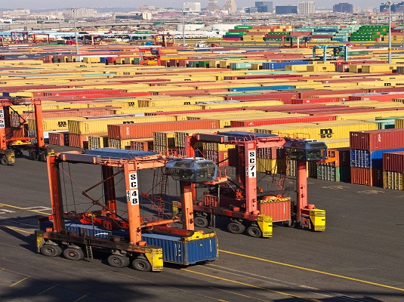
Section 7: Information Clearinghouse and Communications
Develop communications and outreach strategy to promote use of program resources
Create web-based information clearinghouse
Notes:
Database of emission reduction strategies; funding opportunities; methodologies/guidance documents; studies.

Slide 24
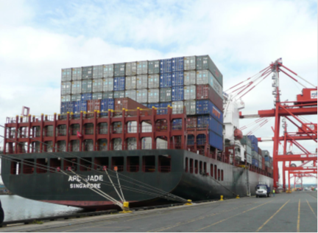
Section 8: Inventories and Metrics
Develop inventory guidance
Acknowledge various levels and quality of data
Consider emerging data sources (e.g. citizen science)
Assist and encourage development of refined port-related inventories
Facilitate simple, non-technical communication of inventories to stakeholders
Provide guidance on indicators/metrics
Identify and/or develop calculators
Provide guidance on other programs’ indictors, metrics, and tools
Section 8
Notes:
This goes to the 2nd charge question but also in the “resource” category (i.e., EPA should provide resources for…..
1. Many different types of inventories from simple screening inv that probably have high level of uncertainty and not much activity/equipt level data to high definition activity based inventories resulting from intense data collection & robust calcs.
Each serve a purpose - provide guidance for developing each type & explain shortcomings, strengths of each.
2. Communication bullet:
-clearly articulating the methodologies and assumptions used to develop inventory (transparency)
-Using similar meth & ass. From yr to yr (consistency)
-Using best practices to estimate & document emissions, and highlighting uncertainties = honest & accurate communication
-EPA should develop best practices to enable ports to communicate effectively with stakeholders
3. indicators/metrics.
Inventory is starting point. Indicators (qualitative w/yes or no answer) and metrics (quantitative) are key to measuring progress just remember one size doesn’t fit all; different data quality may be acceptable and different measurements for each port.

Slide 25
Section 9: Ideas Felt to be Non-Consensus or Out of Scope
Prioritization of these recommendations, along with other emissions reduction strategies (including regulatory approaches), was raised in some Workgroup discussions. The Workgroup did not reach a consensus on this broader prioritization, since our scope was defined as a voluntary initiative. The following statement reflects the concerns expressed by those members:
The Workgroup has provided EPA with numerous recommendations, a number of which will require significant time and expense for the Agency to implement. In prioritizing which requests to adopt in the near-term, EPA should, first, articulate its air quality and human health goals with respect to reducing freight emissions, including a timeline for reaching those goals; and then determine the combination of strategies it should employ to reach those goals (including funding, voluntary, regulatory, and guidance-oriented strategies). Such an assessment will help ensure that EPA’s actions are driven by its mission (protect human health and the environment) and timely delivered.

Slide 26
Key themes
The scope of this work is measurement and voluntary improvements as part of an EPA Ports strategy.
“Ports” is defined to include all the equipment moving in and out of ports – vessels, trucks, trains, terminal and warehouse cargo-handling equipment, and harbor craft.
Increased funding and initiatives directed to:
Vessels, trucks, trains, cargo-handling equipment and operational improvements
Upgrade and modernize equipment
Streamline verification of emissions benefits for new technologies and methods
Recognition that operational and energy efficiency improvements also result in environmental improvements
Mechanisms are to be established to quantify and recognize these in both voluntary and regulatory programs
Align with and leverage the many federal, state and other programs to better support environmental improvement in and around ports.
Green Marine, SmartWay and Clean Cargo are specifically recognized.

Slide 27
Thank you
Nina Sofia Mestan (Craft)

