Slide 1
Options for Aftermarket Parts
NACAA Mobile and Fuels Committee
March 22, 2016 2PM EST
Washington, DC

Slide 2
Overview
Purpose of Call
EPA Policy Background
OTC Actions to Date and Estimated Air Quality
Benefits
4. Recommendations and Options
5. Next Steps and Questions

Slide 3
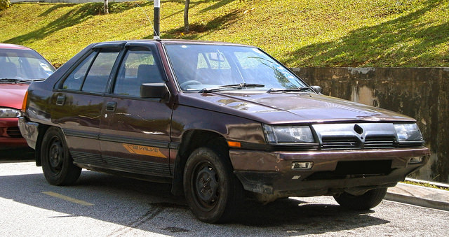
Why Aftermarket Converters?
Light duty vehicles remain on the road longer than before
Slower emission benefit from fleet turnover
Failure rate of original converter increases over time
Disconnect between useful life of vehicle (120,000 in Tier 2 and 150,000 miles in Tier 3) and converter life (80,000 miles)
When warranties end, aftermarket parts are important
OEM converters are expensive
Aftermarket parts provide a more affordable option
Cleaner aftermarket converters provide mobile emission reductions without need for fleet turnover

Slide 4
Why Aftermarket Converters (cntd.)?
Aftermarket Converters are an important program for areas to:
Maintain/Reduce Ozone/PM_{2.5} Emissions
Continue to Reduce Air Toxics
Participate in 2015 NAAQS Strategy (SIPs or Ozone Advance)
Reduce Impact from In-Use Vehicles
May be needed for Anti-Backsliding (more on this later)
With OBD, reductions will occur in areas without I/M

Slide 5
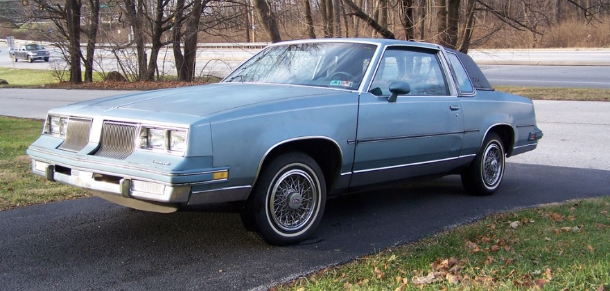
Current Policy
USEPA’s enforcement policy set in 1986 and has not been updated to reflect improvements in technologies & emission standards
Current policy is an enforcement policy, not a direct regulation
Requirements:
70/70/30% reduction for HC/CO/NO_{X} from catalysts
25k warranty
Testing: Worst case vehicle
Aging: On-vehicle mileage accumulation
http://www.epa.gov/sites/production/files/documents/amccpolicy.pdf

Slide 6
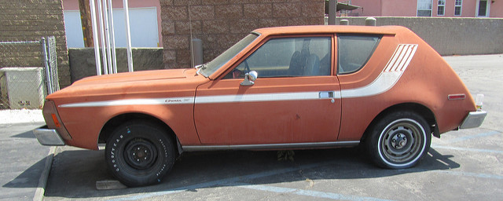
EPA’s Policy Movement
OECA is in the process of ending the 1986 policy
EPA would revert to the 1974 Interim Tampering Enforcement Policy “Memo 1A”
Built under assumption that aftermarket parts don’t adversely affect emissions
There are no specific requirements or aftermarket standards
OTC is concerned that either/or:
Only legal options would be OEM and CARB Aftermarket, which would be expensive and reduce consumer compliance
There would be no standards (e.g., emissions, warranty length) for aftermarket converters and a race to the bottom as a result
Concern whether OECA can/will enforce
the 1974 Interim Policy
Would using the 1974 Interim Policy result in backsliding?
http://www.epa.gov/sites/production/files/documents/tamper-memo1a.pdf

Slide 7
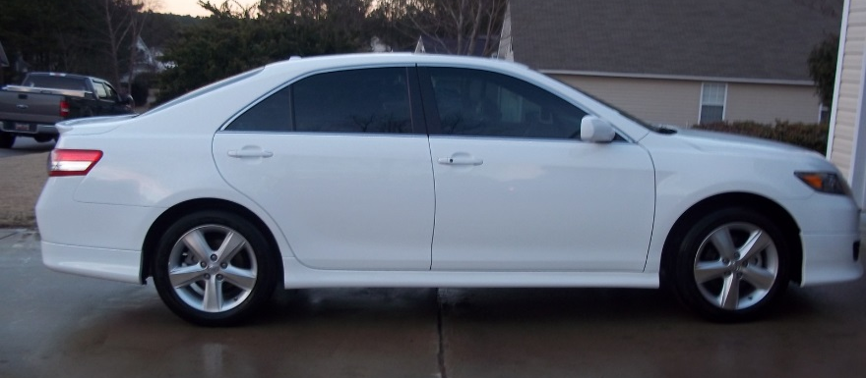
Recommended Update to Federal Program
OTC submitted a recommendation for updated requirements to an enforcement program to USEPA in April, 2011, in response to a 2009 resolution
Recommendation calls for
Mass based catalyst performance
50k mile catalyst warranty
Testing
Non-OBD: Four worst case test vehicles
OBD: Worst case vehicle aggregation or CA Executive Order
Aging: Allow RAT-A or dynamometer
Roughly estimated 49 State benefit (tons per day):
HC | NO_{X} | CO
48 | 282 | 462
http://otcair.org/upload/Documents/Correspondence/OTC%20Aftermarket%20Catalytic%20Converter%20letter%20to%20EPA%20Plus%20Attachments%202011-04-08.pdf

Slide 8
OTC Model Rule/CARB Program
Allows states to move forward with requiring cleaner converters
Based on rules adopted by several OTC states (NY, ME, VT)
Model Rule requires sale of aftermarket converters with an CARB Executive Order (EO)
Presents issues with 49-state vehicles
Policy package includes MOVES methodology and a model guidance document for catalyst manufacturers and installers
Estimated Emission Benefits in the OTR:
http://otcair.org/document.asp?fview=modelrules

Slide 9
Industry Voluntary Program
Industry developed a proposed voluntary “green” catalyst certification program
Requirements for certification, warranty, etc. are similar to our Recommended Update to Federal Program
A voluntary program will be a harder lift for SIP credit and guaranteed reductions
Supported by MECA and Auto Care Association

Slide 10
Comparison of Options
Option | Challenges
1. Status Quo | Does not result in technological acceptable emission reductions
2. 1974 Interim Policy | Enforcement becomes harder, likely would not result in acceptable emission reductions and potentially lead to emission increases, race to the bottom
3. OTC Recommended Federal Update | EPA must act and might not have the authority to do as they did in 1986
4. OTC Model Rule/CARB | Heavy reliance on CARB certification, interstate sale issues, not good option for 49 state cars
5. Voluntary Program | Emission reductions less guaranteed, SIP credit more challenging

Slide 11
Building a Coalition
Why? EPA has not moved forward to improve the broken aftermarket policy despite repeated calls from the Current Partners:
OTC States
MECA
Auto Care
Colorado
By expanding the coalition we hope to push EPA to act. Some of the Potential Partners:
Other states
NACAA
Consumer Advocates?
Enviros?
This coalition could help in the future with other mobile source issues

Slide 12
Next Steps
Continue RPO calls on options (including NACAA rep)
Call with industry groups
Develop other coalition members
EPA
Continue to press OTAQ
Call with OECA
Other Steps?

Slide 13
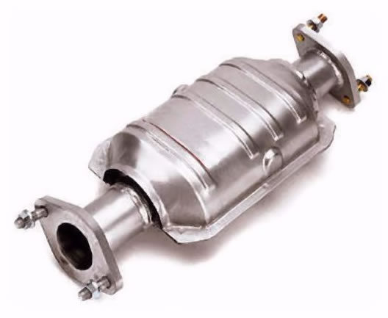
Questions and Discussion

