Slide 1

Final Phase 2 Fuel Efficiency and GHG Emission Standards for Heavy-Duty Vehicles
September 13, 2016

Slide 2
Overview
Regulated heavy-duty vehicle categories
Phase 2 program highlights
Key changes from the proposal
Summary of benefits and costs
Next steps

Slide 3
U.S. Transportation Sector Energy Use
Heavy-duty vehicles responsible for about one fifth of the energy use and GHG emissions from transportation sources
In terms of energy use, heavy-duty vehicles are also the fastest growing transportation sector in the U.S. and globally
Heavy-Duty
Source:
U.S. Energy Information Administration
Annual Energy Outlook 2014

Slide 4
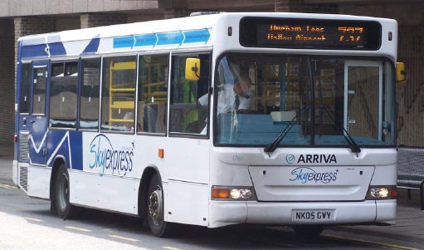

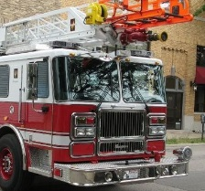

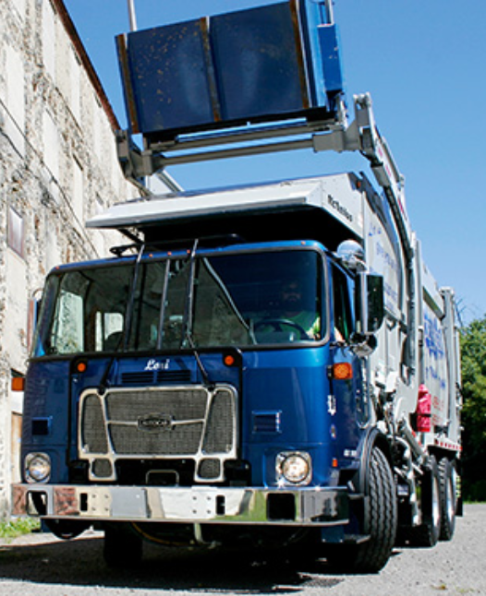
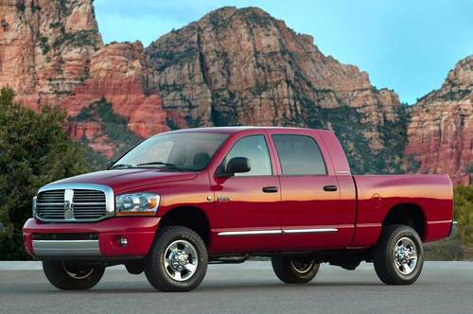



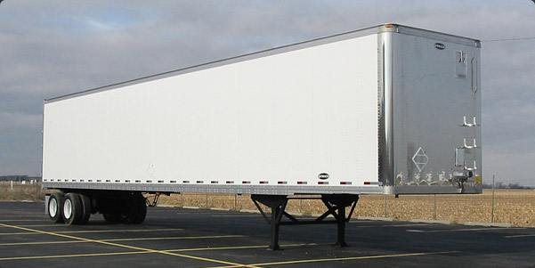
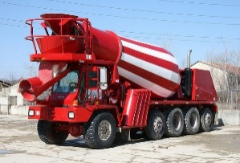
Heavy-Duty Truck Regulatory Categories
Combination
Tractors
Vocational Vehicles
Large Pickups & Vans
Trailers Pulled by Combination Tractors (currently unregulated Federally)
60% of HD Fuel Consumption & GHG Inventory (together)
17% of HD Fuel Consumption & GHG Inventory
23% of HD Fuel Consumption
& GHG Inventory
Standards in g/ton-mile
& gallons/1,000 ton-miles
Standards in g/ton-mile &
gallons/1,000 ton-miles
Standards in g/mile & gallons/100 miles

Slide 5
Phase 2 Final Program Highlights (1/2)
Final program is technology-advancing and performance-based, and can be met through a combination of existing technologies and advanced technologies
  Nearly full use of most Phase 1 technologies – with additional optimization to improve technology effectiveness
  Significant use of emerging and advanced technologies by 2027
  The agencies revised the proposed standards based on a rigorous re-assessment of all technologies in this time frame and the final program will achieve up to 1.1 billion tons of CO₂ reductions (more than the NPRM) and up to 2 billion barrels of fuel savings

Slide 6
Phase 2 Final Program Highlights (2/2)
As proposed, the Phase 2 standards will begin:
    In Model Year 2018 for EPA trailer standards, which were not regulated in Phase 1
    In Model Year 2021 for all other EPA categories, and all NHTSA standards
    (EISA requires NHTSA to issue standards with 4 years lead time)
All Phase 2 standards will be fully phased in by Model Year 2027
Recognizing the unique nature of the industry, the Phase 2 includes important compliance flexibilities to manufacturers, e.g.,
  Averaging, baking and trading program (ABT)
  Additional lead time for small business manufacturers

Slide 7
Phase 2 GHG/Fuel Reductions
Maximum vehicle fuel savings and tailpipe GHG reduction (%) based on per vehicle emissions standards versus baseline standards
Other subcategory reductions may vary
 | 2027 CO₂/Fuel Consumption Reductions (per new vehicle)
Tractors (includes engine reductions) | 25%
Trailers | 9%
Vocational Vehicles (includes engine reductions) | 24%
Pick-ups & Vans | 16%
Separate Engine Standards (for Tractor and Vehicle applications, diesel value shown) | 5% tractor 4% vocational

Slide 8
Technologies that could be used to meet Phase 2
Engine, transmission, and driveline improvements
Extended and workday idle reduction technologies
Aerodynamic devices
Lower rolling resistance tires
Automatic tire inflation systems
Weight reduction
    Engine stop start
    Powertrain hybridization
    Combustion optimization
    Improved air handling
    Reduced friction within the engine
    Improved emissions after-treatment technologies
    Waste heat recovery

Slide 9
Stakeholder Outreach and Public
Comments
Extensive stakeholder during all stages of rule development
  Over 400 meetings with a wide-array of stakeholders
Two public hearings during Proposal’s 2015 public comment period
    Over 60 testifiers in Chicago, IL
    Over 60 testifiers in and Long Beach, CA
Issued a separate Notice of Data Availability in March 2016
  This included an additional 30-day comment period
Significant number of public comments
    >200,000 comments
      Organizations: 195
      Citizens: 195
      Mass Comment Campaigns: 7

Slide 10
Phase 2 Final Program:
Key Changes from Proposal (1/2)
Improved test procedures
  New cycle-average fuel map methods reflect the most accurate forms of engine testing for GHG and fuel consumption
  Based on extensive research, testing and stakeholder feedback
More robust compliance provisions
  Enhanced Selective Enforcement Audit provisions for aerodynamics to ensure production vehicles will achieve aerodynamic performance required by the standards
More stringent separate diesel engine standards
  Updated technology deployment projections, based on comments and new data
Revised vocational standards
  Increased effectiveness of vocational technologies based on how these vehicles operate in-use
  Standards are more tailored to in-use applications, to ensure the right technology for the job
  New in-use data resulted in GEM’s duty cycle weighting factors to shift toward a greater recognition of cost-effective idle reduction technologies (e.g., automatic engine shutdown, with allowable over-rides)

Slide 11
Phase 2 Final Program:
Key Changes from Proposal (2/2)
Significant improvements in GEM (vehicle compliance computer model)
  Robust and representative road grade, based on U.S. highways and truck activity
  Accurate representation of engine in the tractor
  Improved test procedures to recognize more technologies for powertrains, transmissions, axles, aerodynamic coast-downs
Credit generation opportunities for final stage body builders/up-fitters
  By meeting delegated assembly requirements; via agreements with certifying chassis manufacturers
Advanced technology multipliers for next-generation clean technology
      Multipliers of 5.5 for fuel cell, 4.5 for electric vehicle, 3.5 for plug-in hybrid technologies
    Finalizing particulate matter-filter based standards for diesel auxiliary power units (APUs) installed on new tractors
Further minimizing impacts on small businesses
  Exemptions for specialty trailers
  Simplified compliance structure for small volume manufacturers that produce custom vocational vehicles

Slide 12
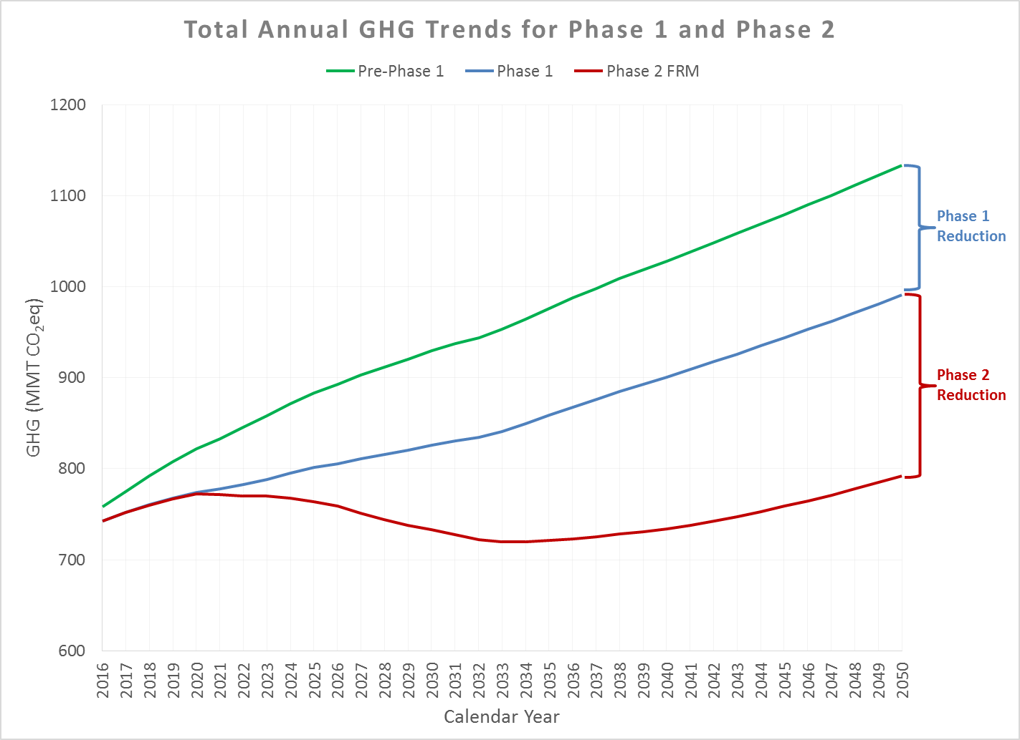
Total Annual GHG Trends for Phase 2
In the face of sustained growth,
Phase 2 achieves a 13-year period of net decreasing GHGs and fuel consumption.

Slide 13
Summary of Phase 2 GHG and Fuel Reductions, Costs and Benefits
 | Final Phase 2 MY 2018-2029 (in addition to Phase 1)*
Fuel reductions (Billion Gallons) | 82
GHG reductions (MMT CO₂eq) | 1,100
 | Billions of 2013$
Vehicle and maintenance costs | -$27
Fuel savings (pre-tax) | $170
GHG, non-GHG & other benefits | $90
Net benefits | $230

Slide 14
Per Vehicle Costs and Vehicle Payback for Final Standards
Cost increase shown represents average 2027 vehicle vs. average Phase 1 vehicle
  Gradual introduction of new technology and gradual increase in costs as standards phase in
Costs shown include engine costs
Similar favorable payback periods as the proposal
Per Vehicle Cost and % Increase in Typical Vehicle Price*
 | Phase 2 Projected Average Cost Increase for MY 2027 Vehicle (Relative to 2018 vehicles)
Tractors | $12,400** <12% cost increase
Trailers | $1,110 <4% cost increase
Vocational Vehicles | $2,700 <3% cost increase
Pick-ups/Vans | $1,360 <3% cost increase
Final Standards Payback Period for MY 2027 Vehicles (proposal)
Tractors/Trailers | 2nd year (same)
Vocational Vehicles | 4th year (proposal: 6th)
Pick-ups/Vans | 3rd year (same)
*Assumed vehicle prices: $100,000+ for tractors, $25,000+ for trailers, $100,000+ for vocational vehicles and $40,000+ for HD pickups/vans
**Includes cost for PM traps for APUs recognized in Phase 2

Slide 15
Phase 2 Collaboration
An important goal of this joint action is to create a national program that would help manufacturers continue to build a single fleet of vehicles and engines.
  The program fully harmonizes EPA and NHTSA standards
  Phase 2 was developed in close consultation with the California Air Resources Board, and we believe we are finalizing a program that California can adopt

Slide 16
Next Steps and Additional Information
What’s next?
  Publication in the Federal Register this fall
  Implementation guidance
More information on the final Phase 2 rule can be found at:
http://www3.epa.gov/otaq/climate/regs-heavy-duty.htm
  http://www.nhtsa.gov/fuel-economy

