Slide 1
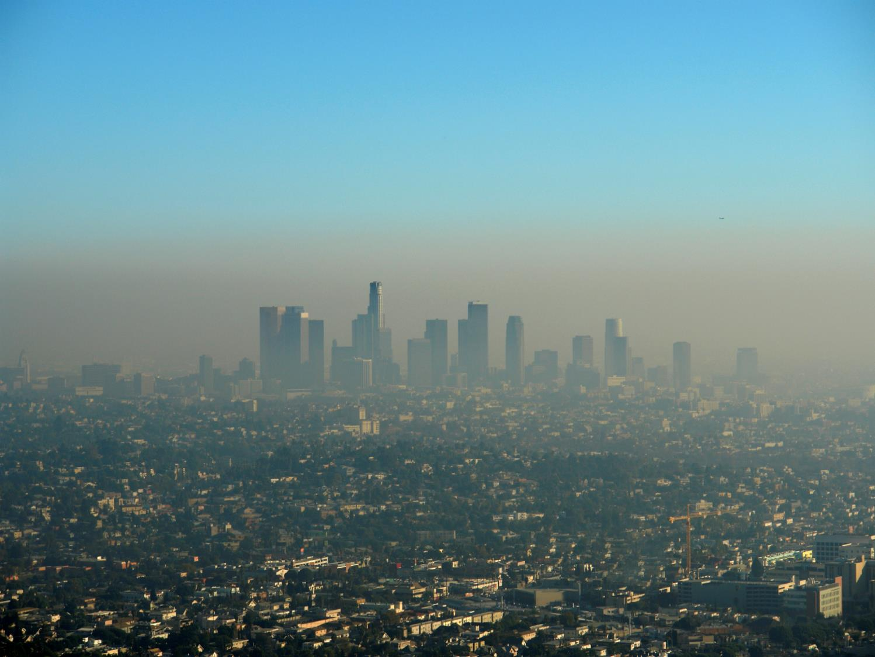
Air Quality Index Mapping Using Model, Regulatory Monitor, and Sensor Data in Real-Time
Scott A. Epstein, Ph.D.
Program Supervisor, Air Quality Assessment
Planning, Rule Development and Area Sources

Slide 2
Acknowledgements
South Coast AQMD Air Quality Assessment Group
Melissa Sheffer, Senior Meteorologist; Mark Bassett, PhD; Melissa Maestas, PhD; Xiang Li, PhD; Elham Baranizadeh, PhD; Nico Schulte, PhD
Notes:
I would first like to start by acknowledging all of the members of the AQ Assessment group that helped do a lot of the work shown in this presentation.

Slide 3
The South Coast AQMD
17 million residents
4 counties
3 air basins:
South Coast
Salton Sea (Riverside County portion)
Mojave Desert (Riverside County portion)
Non-attainment of federal PM2.5, ozone, and PM10
Typically over 150 exceedance days per year

Slide 4
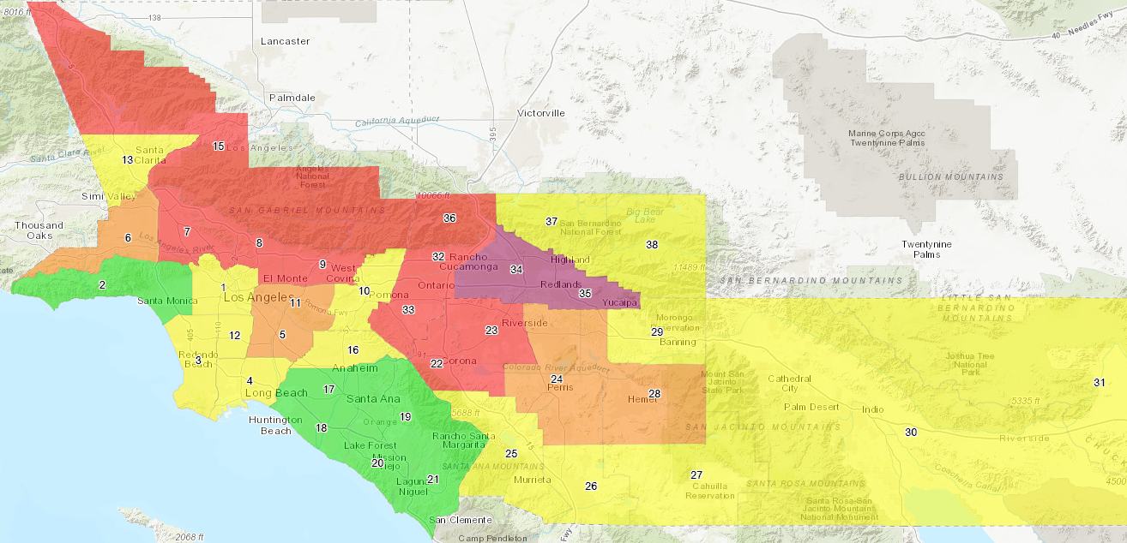
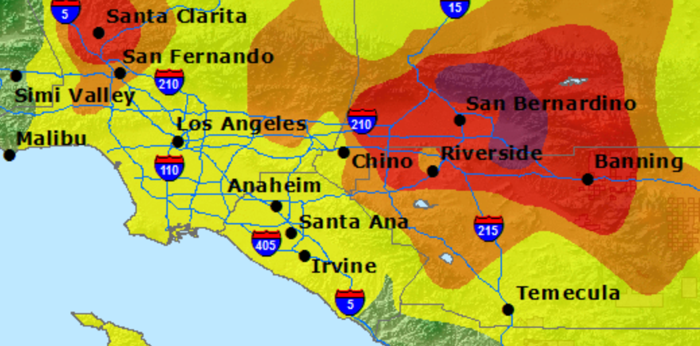
Current Methods of Displaying Real-Time Air Quality Data
South Coast AQMD “Proxy Method”
AirNow Inverse Distance Weighted Interpolation
www.aqmd.gov/aqdata
www.airnow.gov
Limitations identified:
Location of monitor that is driving an area’s current AQI is unclear
Distance-weighted interpolation doesn’t account for complex terrain
Public often looks at multiple maps to understand current air quality (PurpleAir map) and does not interpret low-cost sensor data appropriately
Some regions in the “Proxy” map are too large to accurately represent localized events
Notes:
Unclear to residents where the monitors are that are measuring the pollutants that drive the current AQI

Slide 5
Monitor/Model/Sensor Blended Map
Pollutant | Method | Far from monitors | Near monitors
PM_{2.5} | Fill in gaps between monitors using forecasts* and low-cost sensor data | Models and low-cost sensor data drive concentration | Monitor data drives concentration
O₃ | Fill in gaps between monitors using forecasts* | Models drive concentration
PM₁₀, NO₂, CO | Natural neighbor interpolation | Monitor data drives concentration
Schulte, N., Li, X., Ghosh, J.K., Fine, P.M., Epstein, S.A. Responsive High-Resolution Air Quality Index Mapping Using Model, Regulatory Monitor, and Sensor Data in Real-Time, accepted in Environmental Research Letters
5

Slide 6
The User Experience

Slide 7
The User Experience
San Bernardino
AQI: 207
AQI Category: Very Unhealthy
Dominant Pollutant: Ozone 8 Hr Average
Pollutant | AQI
PM_{2.5} | 70 (calculated)
O₃ (8 hr) | 207 (measured)
PM₁₀ | 60 (measured)
NO₂ | 8 (measured)
CO | 3 (measured)

Slide 8
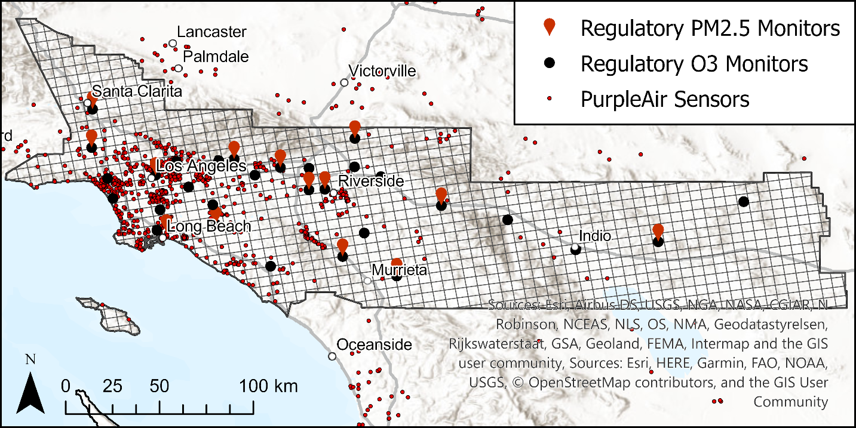
Treatment of Low-Cost Sensor PM2.5 Data
Quality Control PurpleAir Data
By comparing the simultaneous measurements from the two channels within each sensor and applying statistical criteria
Calibrate PurpleAir Data
Using collocated BAM data and correction for relative humidity
Combine individual sensors to estimate the average concentration in a grid cell
To “smooth” variation from local source impacts, we average at least 3 sensors in each grid cell

Slide 9
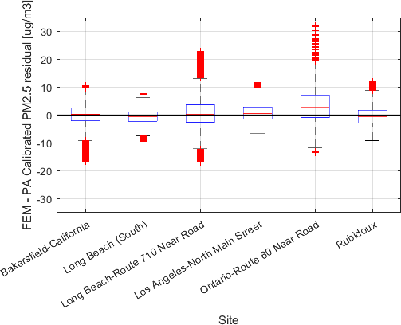
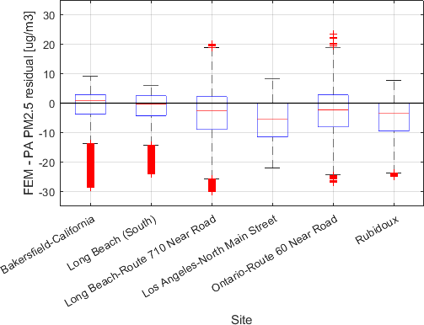
Can We Trust the Low-Cost Sensor Data?
Not calibrated
Calibrated
645,000 hourly data points (Purple Air with collocated FEM) are used to derive a calibration equation
Calibration equations adapted from: Malings et al, 2019. Aerosol Science & Technology

Slide 10
Blending Monitor/Model/Sensor Data
Smoothed Monitor/Model/Sensor
Monitor/Model
Concentration “surface” is fixed to regulatory monitors. Between monitors, model and low-cost sensor data modifies the concentration surface based on their relative uncertainties.

Slide 11
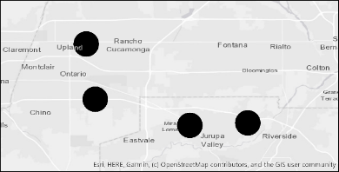
Evaluating Performance Compared to Other Methods
Leave one out cross validation used for all pollutants
Root Mean Square Error (all pollutants)
Monitor
x
Error 1
Pollutant | Proxy | IDW | Blended
PM_{2.5} [μg m⁻³] | 7.6 | 7.73 | 5.94
O₃ [ppb] | 10.2 | 8.75 | 7.12
PM₁₀ [μg m⁻³] | 34.7 | 36.1 | 33.6
CO [ppm] | 0.171 | 0.191 | 0.163
NO₂ [ppb] | 7.57 | 6.94 | 6.22
x
Error 2
…
…
x
Error n
Blended map has lower errors than Proxy and IDW approach for all pollutants used in AQI calculation
IDW – Inverse distance weighting as used by AirNow maps

Slide 12
Additional Evaluation of PM2.5 Performance with Monitoring Data from Independent Data Sets
24-hour Average Gravimetric Data (June 30, 2018 – March 31, 2020)
Performed analysis at 11 sites that do not have collocated continuous PM2.5 monitors
North Hollywood Hourly PM2.5 (Oct 11, 2019 – March 31, 2020)
Mission Viejo Hourly PM2.5 (Oct 29, 2019 – March 31, 2020)
PM_{2.5} Root Mean Square Error [$μg m^{−3}$]
Method | Proxy | IDW | Blended
Gravimetric | 4.64 | 4.07 | 3.59
North Hollywood | 8.91 | 9.07 | 7.51
Mission Viejo | 8.83 | 7.31 | 8.87
Gravimetric, North Hollywood, and Mission Viejo monitor data are not used by interpolation or by NOAA model

Slide 13
Additional Advantages of Blended Map During Wildfires
Blended map automatically integrates e-BAM monitoring data
Integration of PurpleAir and NOAA model data helps capture localized smoke plumes that are between regulatory monitors
Higher resolution blended map better represents wildfire plumes

Slide 14
Map Performance Excels During Wildfires
PM_{2.5} RMSE [$μg m^{−3}$] on fire days
Method | Proxy | IDW | Blended
Leave One Out Cross Validation | 7.04 | 6.62 | 6.01
Gravimetric validation dataset | 5.68 | 4.39 | 3.35
North Hollywood validation dataset | 19.2 | 16.8 | 9.15

Slide 15
Our Progress
Presentations of Blended Map
NACAA’s fall membership meeting in October 2019
CAPCOA planning symposium in October 2019
EPA Air Quality Analysis Group in March 2020
CARB Monitoring team in March 2020
CARB AQMIS team in May 2020
Imperial County APCD in June 2020
EPA Center for Environmental Measurement and Modeling in July 2020
PurpleAir in August 2020
Deployment Schedule
Paper accepted to Environmental Research Letters in July 2020
Operational version of scripts running for several months. Scripts will be finalized by Early September.
Website version and mobile app version currently under development and expected in next few months

Slide 16
Conclusions
Advantages of the Blended Map:
More accurate than previous methods, especially during wildfires
More transparent as it clearly distinguishes calculated and measured concentrations
Helps the public interpret low-cost sensor data and its inherent uncertainties
Provides a higher spatial resolution than South Coast AQMD proxy map

Slide 17
Backup Slides

Slide 18
Process to Generate AQI Values
Compute AQI for each pollutant
Compute Maximum AQI (of all pollutants)
Interpolate all pollutants for the current hour
Compute 8 hour ozone and 24 hour PM_{2.5} and PM₁₀ using nowcast

Slide 19
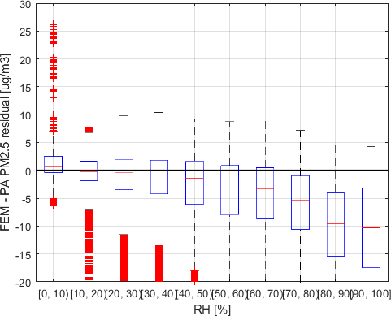
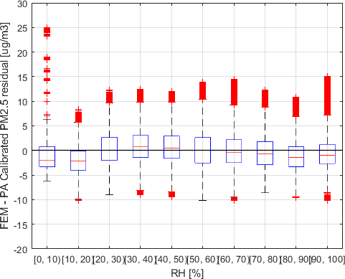
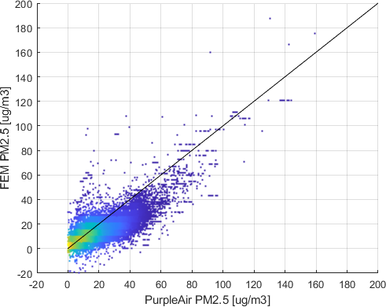
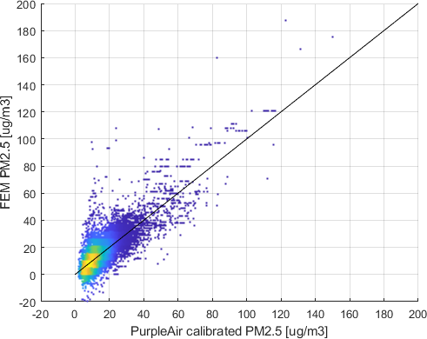
PurpleAir Calibration
Not calibrated
Calibrated
RMSE = 4.6 $μg m^{−3}$

Slide 20
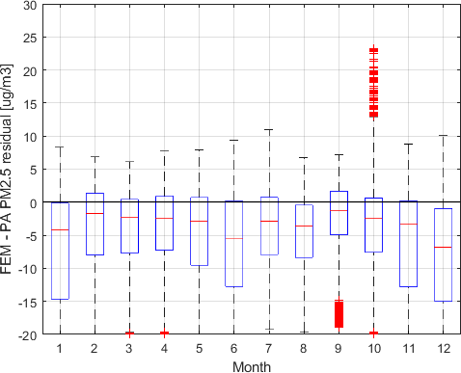
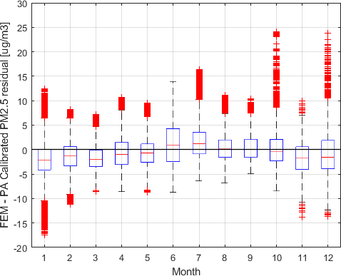
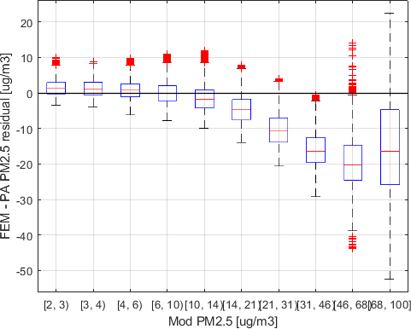
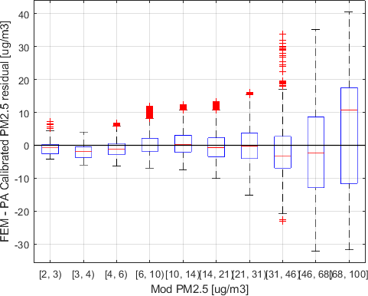
PurpleAir Calibration
Not calibrated
Calibrated

Slide 21
Sensor Blending Method
Quality control, calibrate, and smooth (average in grid cell) the PurpleAir data
Residual Kriging interpolation with modifications
PurpleAir data is included as observations in addition to monitor data
Data is assigned a measurement uncertainty that is used to give more weight to the more accurate monitor data
Measurement Uncertainty
PurpleAir uncertainty is the sum of two components: the RMSE of the collocation curve fit¹ and the standard error of the average in the grid cell²
Monitor data has zero uncertainty
¹ As 1 standard deviation
² Standard error is estimated based on the average concentration when the number of sensors is small

Slide 22
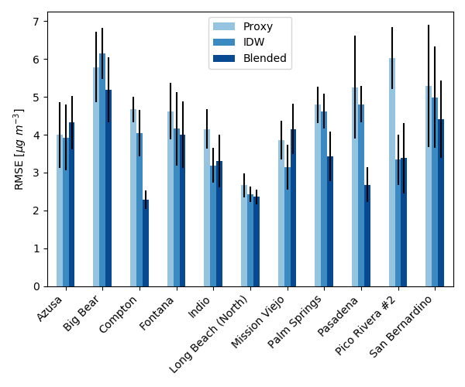
Using Gravimetric Monitor Data to Evaluate Performance
24-hour PM2.5 average of blended map predictions are compared to gravimetric measurements at stations without collocated continuous instruments
Performance is somewhat station dependent
Blended map has lower average RMSE than Proxy and IDW

Slide 23
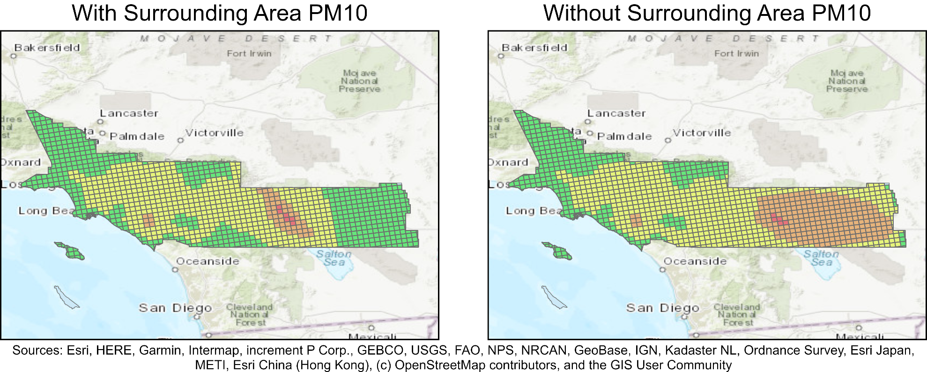
Including PM₁₀ Measurements from Surrounding Areas Produces More Realistic AQI

