Slide 1
Estimating Cancer Risk Associated with Diesel Particulate Matter
October 4, 2018
Francis Steitz, Director

Slide 2
New Jersey’s Diesel Particulate Risk
Using the census tract 2014 National Air Toxics assessment (NATA) ambient concentrations and the California diesel particulate cancer risk factor [3.0 x 10 ⁻⁴ (ug/m³)⁻¹], a diesel census tract cancer risk was generated.
Combining this Census tract risk with GIS mapping software a New Jersey specific Diesel Particulate cancer risk map was created.
Source contribution to cancer risk for Diesel is broken down into two categories.
Onroad mobile – 59%
Non-road mobile – 41%

Slide 3
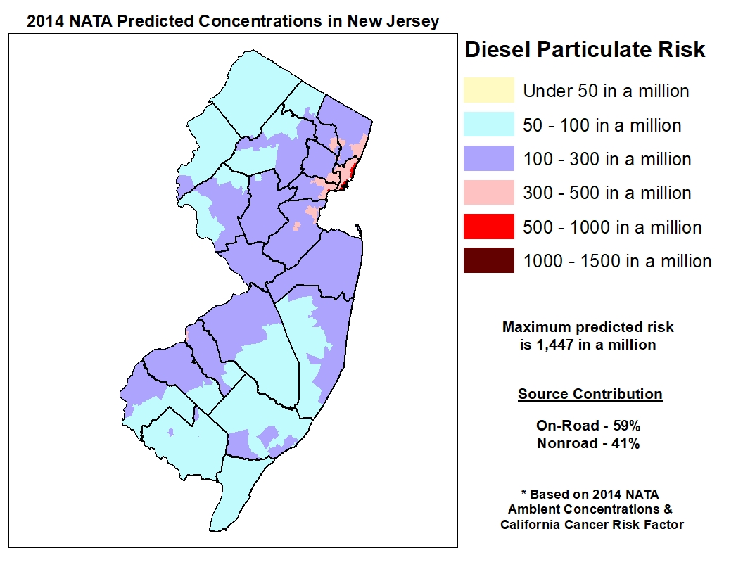
Diesel Census Tract Analysis
* Based on 2011 NATA concentrations and California cancer risk factor.

Slide 4
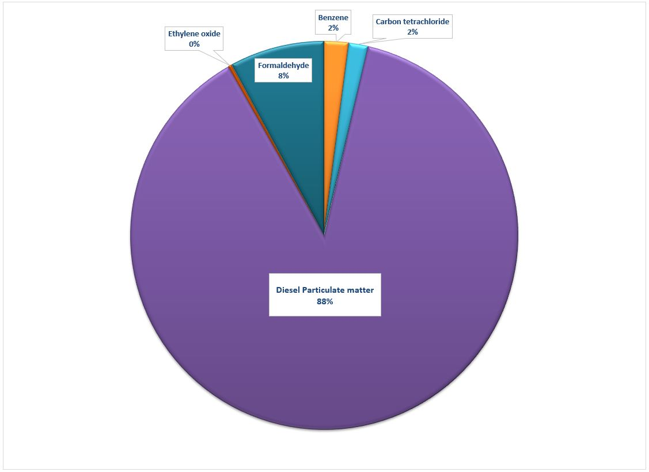
2014 NATA Pollutant Contribution to Statewide Cancer Risk (All Census Tract)

Slide 5
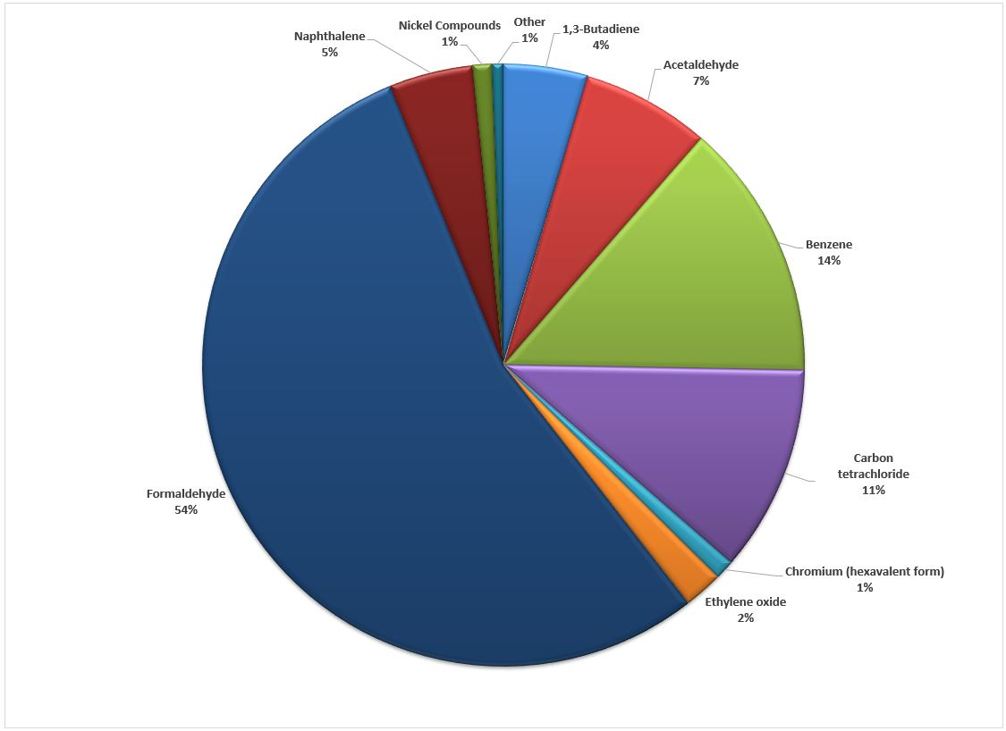
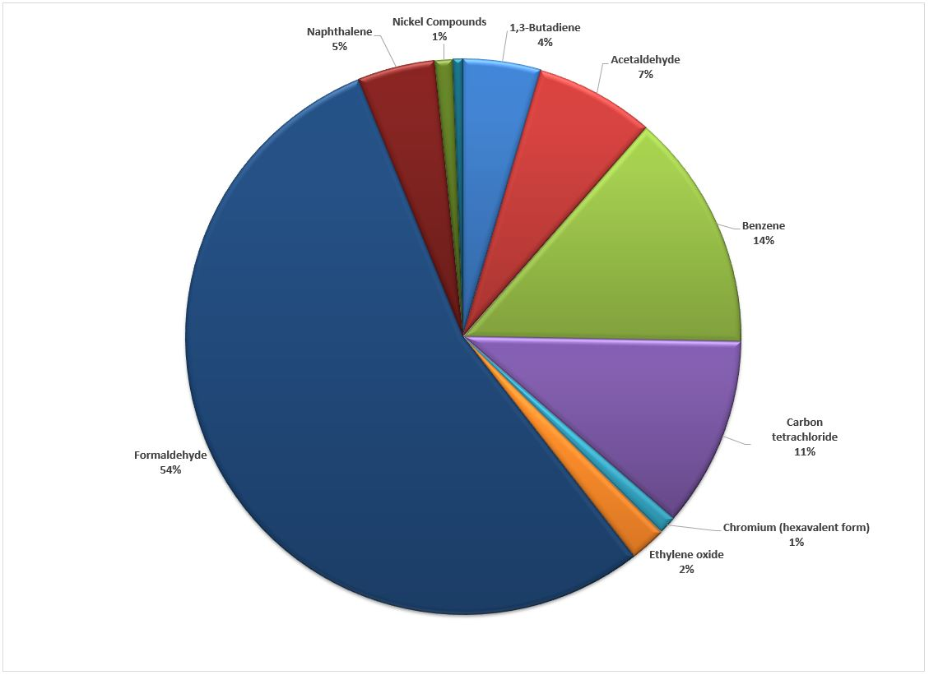
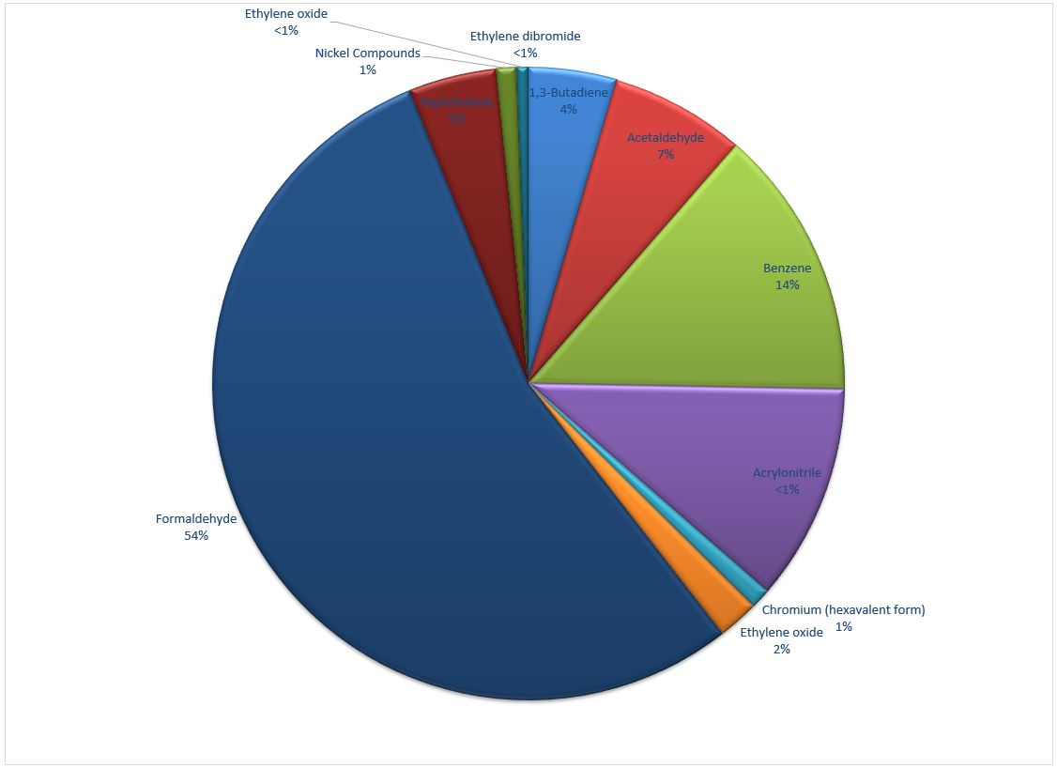
2014 NATA Pollutant Contribution to Statewide Cancer Risk without Diesel (all Census Tracts)

