Slide 1
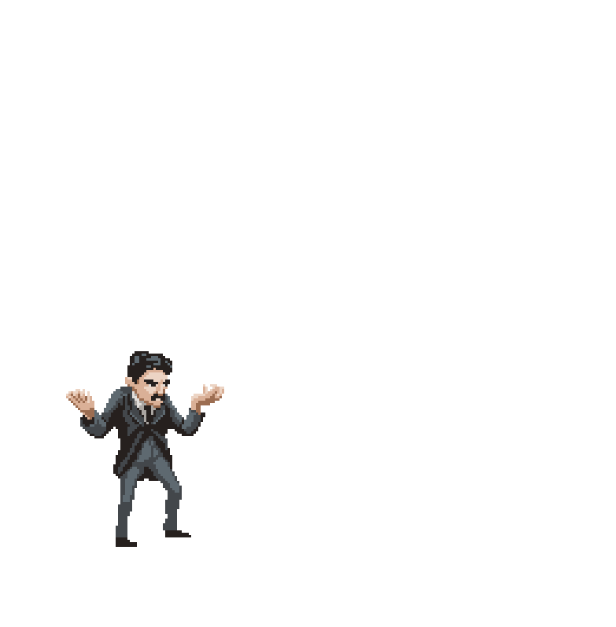
Cybersecurity: A Thrill-Packed Introduction Miles Keogh Executive Director, NACAA
NACAA Coffee Break, Augst 3, 2021
mkeogh@4cleanair.org

Slide 2
The plan for today
What’s so “Cyber” about cybersecurity?
Three flavors of risk
Business Systems
Control systems
Misinfo / Active Measures
A few examples of each
Clean Air Agencies: what are your risks?
Special example: ransomware
Good practices for cyber
A few steps to manage immediate risks

Slide 3
What this isn’t
A substitute for cyber professionals’ expertise
A national cybersecurity policy primer
A classified briefing
I used to run the Research Lab for NARUC
I wrote three papers there and ran a lot of trainings on cybersecurity for agencies, decision-makers, power companies, and international technical assistance recipients

Slide 4
Do you have cyber vulnerabilities?
You probably have an IT department that provides cybersecurity, but they aren’t the people who will be the point of attack – you are!
Air agencies have:
Business process systems
Control systems
Public information / trust
Personal information
If it can be turned into money, it’s valuable

Slide 5
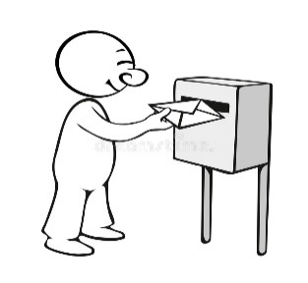
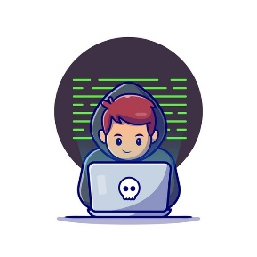
“Cyber” just means “Connected”
“Cyber” connectivity occurs when devices generate and transmit data.
Data becomes intelligence when someone or something takes action based on that data.
data
data
control, data messages
Secure sender
Secure receiver
channel
Intruder
Notes:
Data moves in packets of 1’s and 0’s.
These are chopped up for delivery, and all the parts are routed using computers called “name servers,” using a language called “TCP/IP”
It works like a letter with an address, but all the words travel via different streets & are put back together by the reader
*Secure the data itself, the thing sending data, the pipe it goes through, and the thing receiving data.
There are five components in data communication.
Message: The message is the information (data) to be communicated. It can consist of text, number, pictures, sound, video or any combination of these.
Sender: The sender is the device that sends the data. It can be computer, workstation, telephone, video camera and so on.
Receiver: The receiver is the device that receives the data. It can be computer, workstation, telephone, television and so on.
Communication Channel: The Communication channel is the physical path by which a data travels from sender to receiver. It can be a twisted – pair wire, coaxial cable, fiber optic cable, wireless radio, or microwave etc.
Encoder and Decoder: Without these, two devices may be connected but not communicating, such as a student speaking Urdu cannot understand a student who speaks only German without a translator.

Slide 6
What do they want?
Low
High
Gain System Control – Remotely modify and operate the system (for attack, or to move laterally).
Theft & Extortion – “Exfiltration”. Objective: make money and not be discovered (stealth).
Intrusion – Unauthorized access (incl. espionage)
Frequency
Consequence
High
Low
Notes:
The bad guy’s aim is to establish credentials and administrative rights on a system – to “own” or “pwn” it.
While waterholing, backdoor attacks, SQL injection, tampering, and brute force cracking were significant in criminal operations…
Most newsworthy info operations and cyberattacks start with phishing.
More than 95% of attacks tied to nation-states used phishing to gain a foothold.

Slide 7
So what are some bad things bad people can do?
What is “Malware”? Viruses, Worms, Trojan horses
Social engineering / social media, man-in-middle Phishing, Waterholing
BotNets, DDOS
remote access, rootkits, crypto/ransomware
Misinfo, doxing, swatting
Notes:
All software and firmware can basically do four things: read, write, copy, delete.

Slide 8
Defending business systems
Run of the mill IT systems - servers, user accounts, email systems, data bases, electronic transactions
Defense with credentials, access control, authentication, segmentation, antivirus, firewalls, baselines, backups, application listing, training, response
These are a drag, but you need to take them seriously.
Your job isn’t to build a perfect defense, but as the “end points” it doesn’t help anyone good if you fall victim.

Slide 9
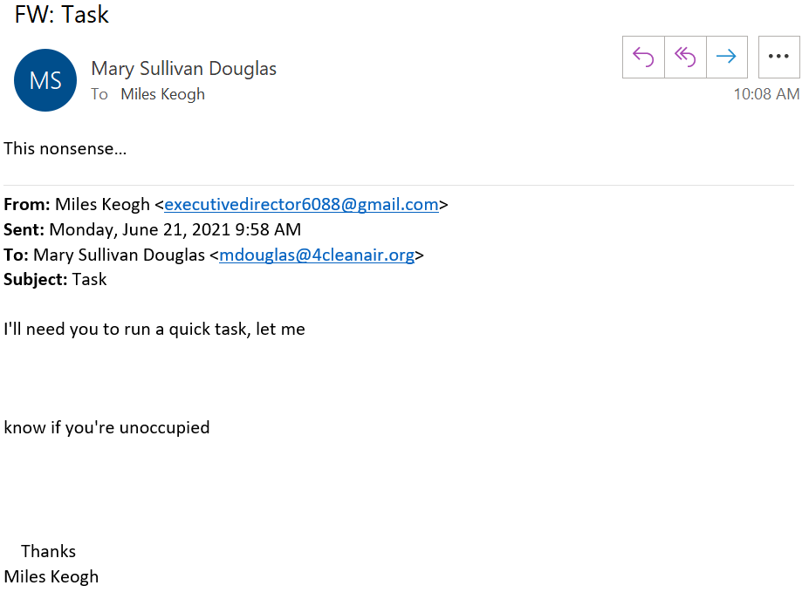
Phishing / Spearphishing
Notes:
ThreatSim: 3 emails gets you a 50% chance, and by 9 you’re over 90%.
Most clicks occur within 12 hours of sending, and most breaches (around 2/3) take months to discover.
More than 95% of attacks tied to nation-states used phishing to gain a foothold.

Slide 10
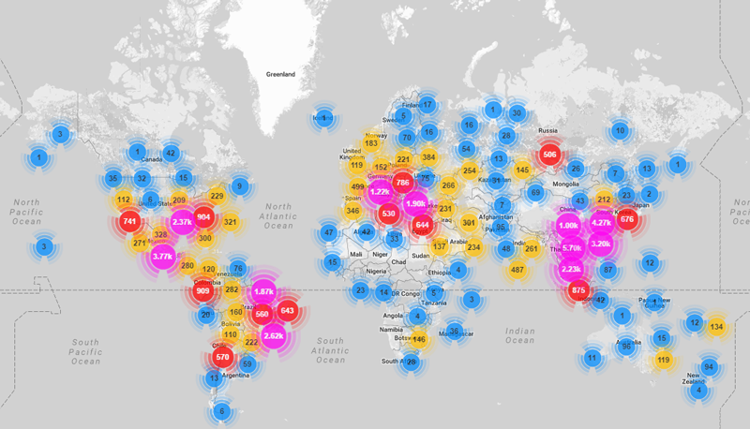
Mirai Botnet / “Internet of Things”
October 2016 attack used printers, copiers, and cameras to DDOS
900,000 routers crashed, focus on the Eastern US

Slide 11
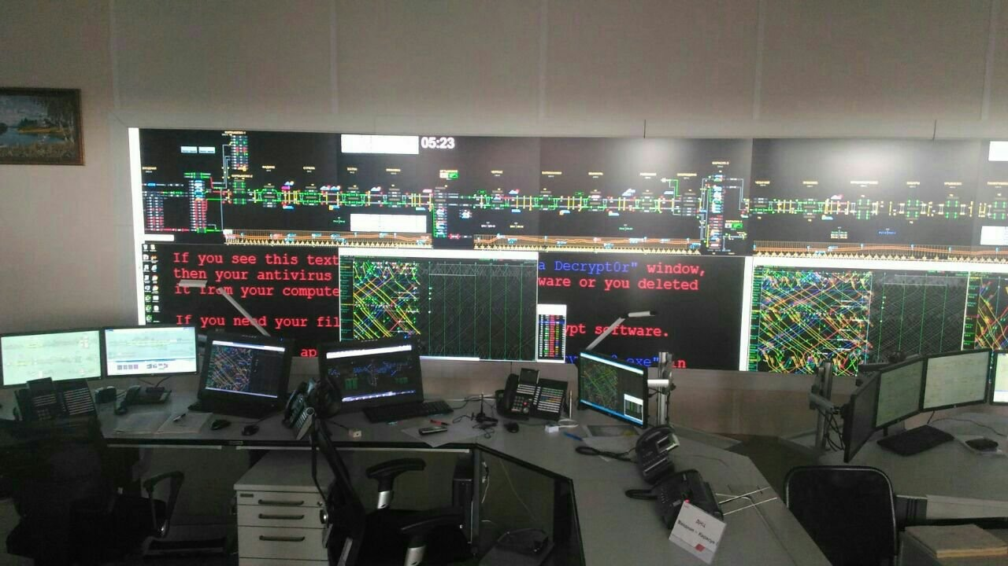
Ransomware
Lansing MI power/water utility - 2015
Wannacry & ShadowBrokers - 2017
Colonial Pipeline -2021
Capability used to migrate out between 18 months and 3 years
Now money creates motive
Notes:
bad in IT, catastrophic for control systems
http://www.networkworld.com/article/3063773/security/michigan-utility-shuts-down-systems-phone-lines-email-after-ransomware-attack.html
Wannacry – NK - May 12 2017 - 230,000 computers, 152 countries

Slide 12
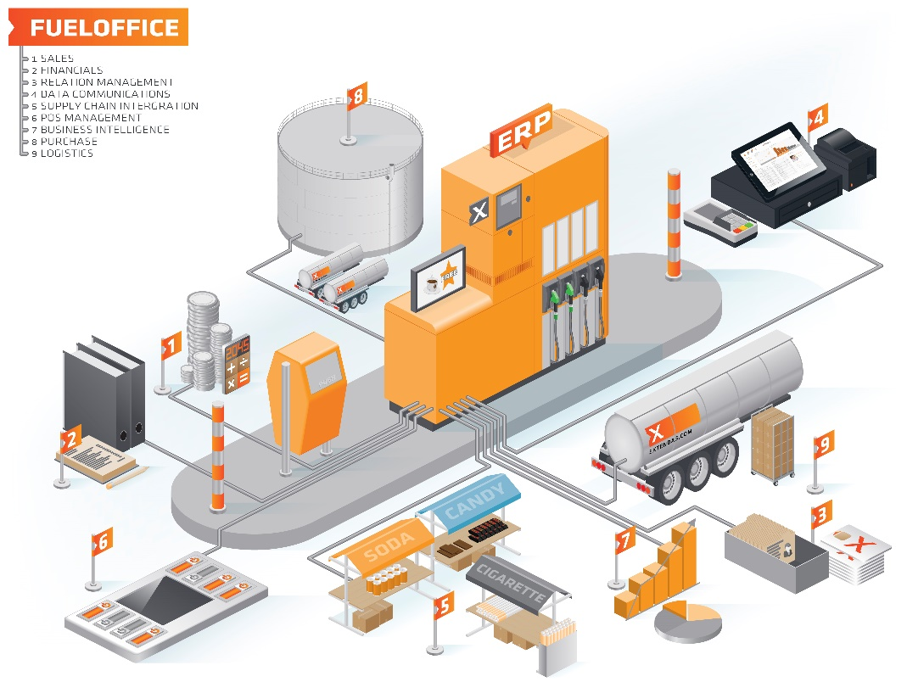
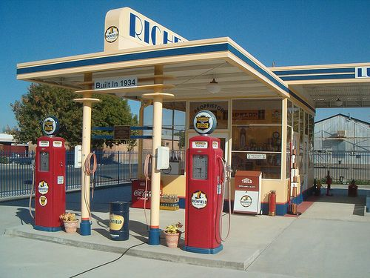
BTW, what’s a control system?
Ubiquitous chipsets interfaced with complex networks that can create, store, transmit, receive data, and take action on that data (so, they’re intelligent! But still pretty dumb.)

Slide 13
Hacking control systems
Industrial Control System (ICS) cybersecurity skill set is highly sought after, highly technical
Save them a lot of work by nailing:
Governance
Planning / design / procurement
Risk management (“treat paperclips like paperclips, diamonds like diamonds”
Sustained implementation
Resilience strategies

Slide 14
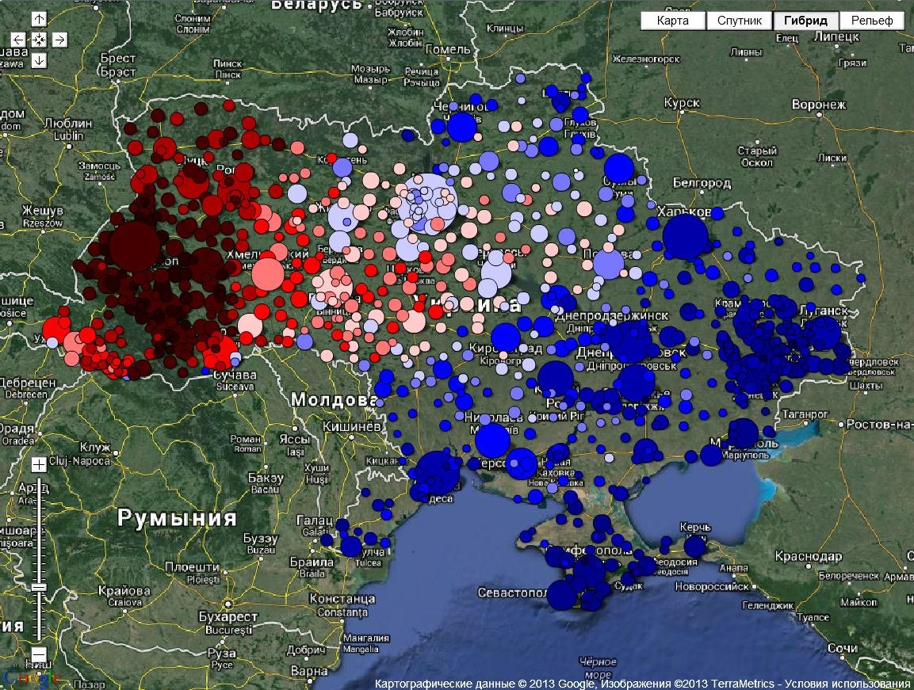
Ukraine
Christmas 2015 attack on Ukrenergos
Outages caused by significant chain of social, IT, and ICS attacks
2016 follow-up attacks
“NotPetya” Ransomware

Slide 15
IT / OT Security - The Bare Basics
Procurement & planning
Protection:
Baseline
Train
Harden
Segment
Patch
Whitelist
Monitor
Response:
Isolate
Go to backups
Report
Do you play a role in any of these?

Slide 16
Misinfo / Active Measures / Doxing
The internet can be a mean place, and this isn’t that.
Coordinated, interlocking intelligence gathering, data release, misinformation efforts
Historically not activist in origin – “outside the process” actions often criminal or international
Intent is to sow chaos and/or undermine faith in social structures, affect policy outcomes using information releases or forged or false information.
Doxing (personal information disclosure) can be used by protesters, but also agitators or criminals - & can be dangerous. (See: “swatting”)

Slide 17
As an organization, you can…
Protecting your people is much more important than protecting equipment, data, systems, or money
Planning & procurement actually matter
View security as risk management (vs. “we comply”)
Integrate security enterprise-wide (“it’s part of the core process” – integrated into reliability, performance, etc.)
Bake security into the design (“it’s in the DNA, not bolted on”)
Capture data and analyze it usefully (if you can’t take the right action, it’s not useful)
Leadership & culture really counts

Slide 18
As an individual, you should…
Careful with social media disclosure
Remove data from data brokerages
Limit exposure to financial fraud
Never reuse passwords, use a password manager
Backups, at least monthly, on a drive
If it seems weird, it’s weird - say something
Pay / don’t pay? Here are some factors…

Slide 19
I will now confront your most challenging questions!
Miles Keogh
mkeogh@4cleanair.org
Or later if you prefer!

